Slide 1
Assessing Dyspepsia in adults in General Practice (including Helicobacter Pylori)
Education for healthcare professionals

Slide 2

What are we referring to…
The term 'dyspepsia' is used to describe a number of upper gastrointestinal tract symptoms which are typically present for four or more weeks & may include any of the following:
Upper abdominal pain or discomfort
Heartburn
Acid reflux
Nausea and/or vomiting

Slide 3

Dyspepsia is very common
Dyspepsia symptoms are estimated to occur in about 40% of the population each year
…optimal management is therefore key due to the numbers affected and the impact on morbidity, the potential for unnecessary prescribing burdens (both in cost and side effects) and pursuing investigations which may not always be necessary
https://cks.nice.org.uk/topics/dyspepsia-unidentified-cause/references/

Slide 4
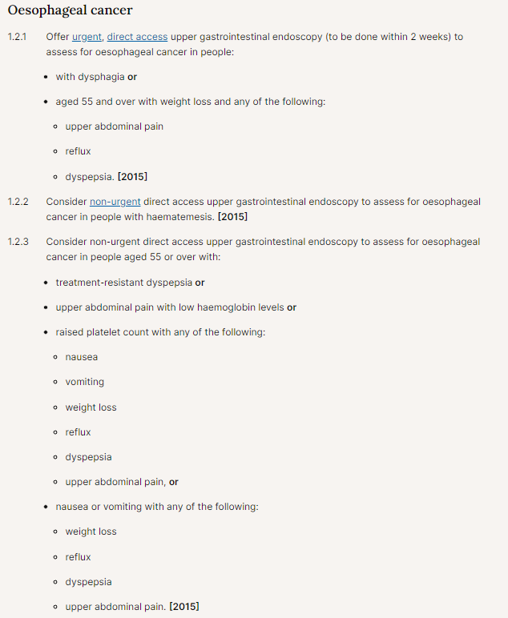
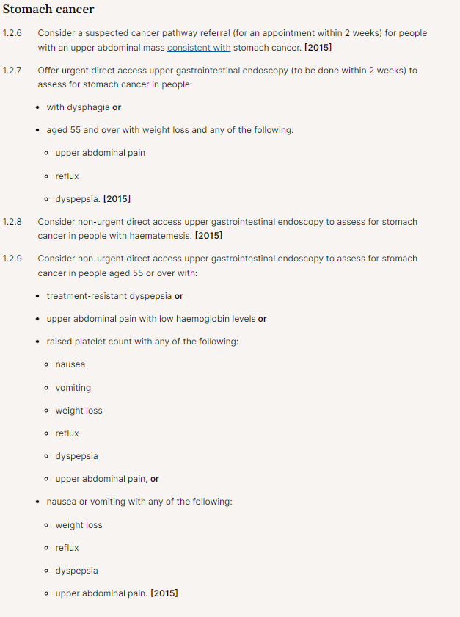

To note:
Dyspepsia in those 55yrs and above which is ‘treatment resistant’ or present with other key symptoms may be a marker of oesophageal or stomach cancer which is why a thorough assessment of dyspepsia is essential.
https://www.nice.org.uk/guidance/ng12/chapter/Recommendations-organised-by-site-of-cancer

Slide 5

Remember to…
Ask about any alarm symptoms that may suggest a complication or other serious underlying pathology, and manage appropriately e.g. fast track suspected cancer referral
Ask about any family history of upper gastrointestinal malignancy or Lynch syndrome
Assess for stress, anxiety, and depression which may worsen symptoms
Assess any lifestyle factors that may cause or exacerbate symptoms:
  Obesity
  Any trigger foods, such as coffee, chocolate, tomatoes, fatty or spicy foods
  The person's pattern of eating e.g. missing meals, consuming large meals, or eating shortly before bed
  Smoking status
  Alcohol consumption

Slide 6

Remember to…
Examine the person, to assess for:
  Weight loss
  Signs of anaemia
  Abdominal mass
  Tenderness
Consider arranging:
full blood count, to check for anaemia and/or a raised platelet count (associated with LEGO-C lung, endometrial, gastric, oesophageal and colorectal cancers )

Slide 7

Check the patient’s medication in detail
Both prescribed and over the counter
Ask about over the counter medication such as antacids, alginates and PPIs that have been tried for symptom relief and advise long-term, continuous use is NOT recommended (as per NICE Guidelines)
Consider reducing or stopping (if possible and appropriate) any drugs that may cause or exacerbate dyspepsia, such as:
    Alpha-blockers
    Anticholinergics
    Aspirin
    Benzodiazepines
    Beta-blockers
    Bisphosphonates
    Calcium-channel blockers
Corticosteroids
    Nitrates
    Nonsteroidal anti-inflammatory drugs (NSAIDs)
    Theophyllines
    Tricyclic antidepressants

Slide 8
Other conditions to consider
Other conditions which may also present with dyspepsia symptoms & might therefore be considered depending on the patient’s presentation include:
Gallbladder or hepatobiliary disease
Pancreatic disease
Cardiac disease
Gastroenteritis
Coeliac disease
Crohn's disease
Irritable bowel syndrome
Small intestine bacterial overgrowth
may also present with weight loss, chronic diarrhoea, and malabsorption
Abdominal aortic aneurysm (rare)

Slide 9
Helicobacter pylori (HP) – who to test
The prevalence of HP in developed countries is falling, and is lower than 15% in many areas in the UK, higher in older people; people of North African ethnicity and those living in a known high risk area
What NICE says:
Test for Helicobacter pylori infection if the person's status is not known or uncertain
- If the person tests positive for H. pylori infection, prescribe according to Pan Mersey Formulary (panmerseyapc.nhs.uk) Cheshire Formulary (cheshireformulary.nhs.uk) or locally agreed treatment protocols
Note: Both HP and NSAIDs are independent risk factors for peptic ulcers, so eradication will not remove all risk

Slide 10


Dyspepsia in pregnancy – affects circa 80%
Raised levels of oestrogen and progesterone in pregnancy are responsible for reducing the lower oesophageal sphincter pressure, meaning that pregnant women can experience reflux from quite early on in a pregnancy. There is the obvious impact of the foetus on intra-abdominal pressure, which increases as the pregnancy progresses.
Assessment should be exactly the same as in non-pregnant patients with the addition of pregnancy-related disorders:
Nausea and vomiting of pregnancy, including hyperemesis gravidarum. For more information, see the CKS topic on Nausea/vomiting in pregnancy
Pre-eclampsia — for more information, see the CKS topic on Hypertension in pregnancy
HELLP syndrome (haemolysis, elevated liver enzymes, and low platelets)
Acute fatty liver of pregnancy (rare)
Dyspepsia – Pregnancy Associated NICE

Slide 11



In summary
‘Assessing Dyspepsia in General Practice’
Always assess for red flags especially in those 55yrs and above
Always check medication as a cause/trigger for dyspepsia including over the counter sources
A thorough assessment of lifestyle factors is key in planning interventions for treatment
Check for HPylori where indicated
Management and Treatment of Dyspepsia in adults in General Practice is described in the next section

