Slide 1


Cheshire & Merseyside
I-CARE & Share
Personalised Care Planning
Support Presentation
Dr Peter Chamberlain

Slide 2
C&M
Personalised Care Planning Process
Identify
Communicate
Anticipatory care plan
Resuscitation decision
Escalation plan
&
Share
EMIS capture template
Personalised Care Plan
North West uDNAR
GSF Tracker

Slide 3

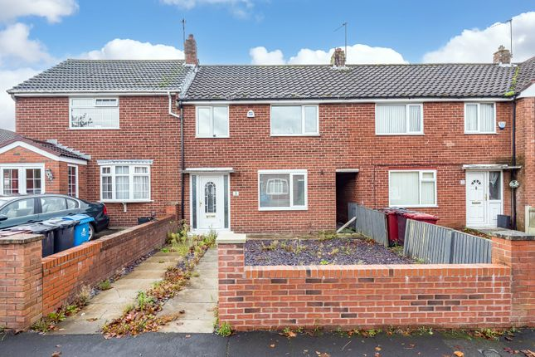
Planning and clinical authority is needed to support carers in managing EOL crisis appropriately
✗
✓

Slide 4
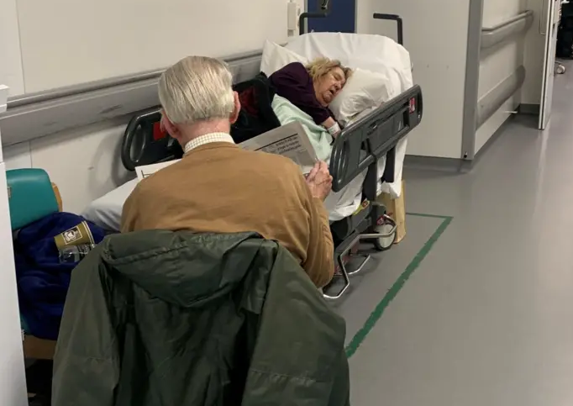
Hospitals are not able to provide adequate palliative care in urgent care settings
Nan Roberts, 88, who gave permission for this photo to be used, had to lie on a trolley for 38 hours

Slide 5
Evidence
RCT (n=309)
- Wishes known and followed: ACP 86% vs Non-ACP group 30% (p<0.001)
Significantly less stress, anxiety, depression and higher family satisfaction
KM Detering et al. BMJ 2010;340:c1345 https://doi.org/10.1136/bmj.c1345
Meta-analysis 113 papers
- Advance care planning was often found to decrease life-sustaining treatment
Increase use of hospice and palliative care and prevent hospitalisation.
Increase compliance with patients’ end-of-life wishes
A Brinkman-Stoppelenburg et al 2014 https://doi.org/10.1177/0269216314526272
Advance Care Planning is cost-effectiveness at a system level
A Bauer et al 20201. https://doi.org/10.1111/hsc.13131

Slide 6

Get everyone on the same page
The value is in the conversation
PCP provides a robust structure
The authority of a clinicians signature is crucial in supporting carers
Coding helps track
Quality is as crucial as
quantity

Slide 7
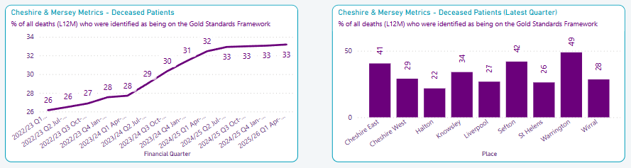
% all deaths on Gold Standard framework

Slide 8
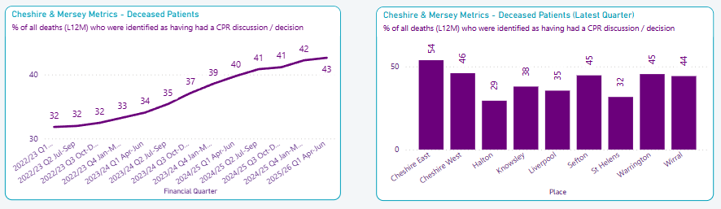
% all deaths who have a DNACPR decision

Slide 9
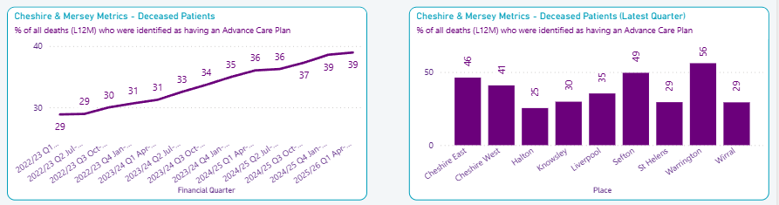
% all deaths who have an Advanced Care Plan

Slide 10
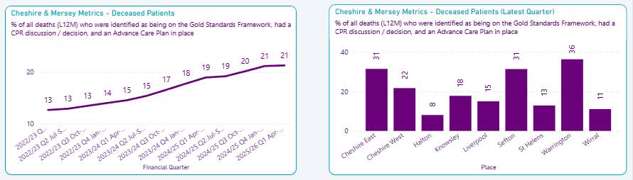
% deaths identified as being on the Gold Standard Framework who had a DNACPR decision and an Advance Care Plan
Goal = 70%

Slide 11
Principles for Places
Each Place to have ONE agreed PCP that meets Electronic Palliative Care Coordinating Systems Standards (EPaCCS)
Key stakeholders: EOL leads / PCNs / GPs / digital
A C&M ICB-approved EMIS/Systm1 template and PCP is available to all areas
This has been extensively tested and being used
Train non-GPs (nurses, pharmacists, etc)
Support practices through local contracting

Slide 12
PCN DES: NHSe moved ACP oversight from NHSe > ICBs
“Updates to the PCN service specifications September 2022
8. Update the anticipatory care requirements to better reflect system-level work on anticipatory care. Replace the current specification with:
a. 8.9.1. ICSs have responsibility to design and plan anticipatory care for their system, of which the following PCN requirements form a part. 11
b. 8.9.2. PCNs must contribute to ICS-led conversations on the local development and implementation of anticipatory care working with other providers with whom anticipatory care will be delivered jointly.”⁹

Slide 13

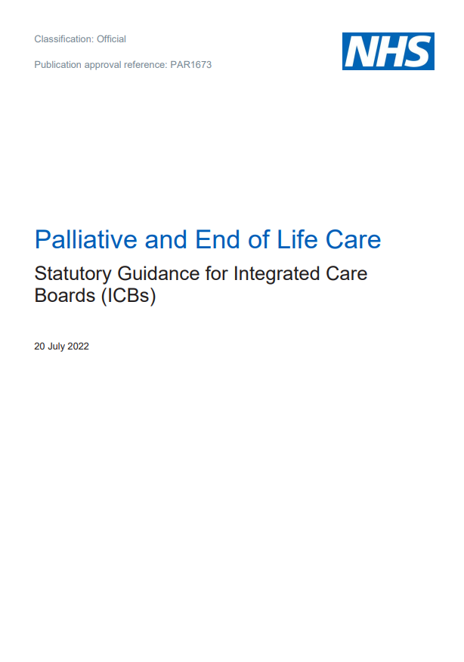
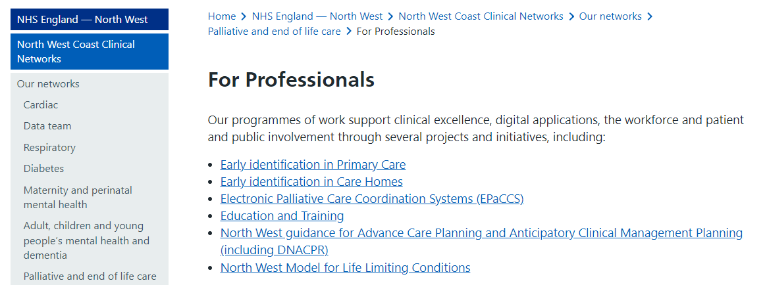
Ambitions for Palliative and End of Life Care:
A national framework for local action 2021-2026

Slide 14
C&M
Personalised Care Planning Process
Identify
Communicate
Anticipatory care plan
Resuscitation decision
Escalation plan
&
Share
EMIS capture template
Personalised Care Plan
North West uDNAR
GSF Tracker

Slide 15
Measures of success:
0.6% GP population on EoL register
100% DNA CPR as Problem coded
70% patients on EOL register have PCP
90% of PCP shared with urgent care

Slide 16
Priority Patients
End of life patients
Patients receiving palliative care
Care Home patients (PCN DES)
May also be used for
Patients with complex needs
Patients with severe long-term conditions

Slide 17
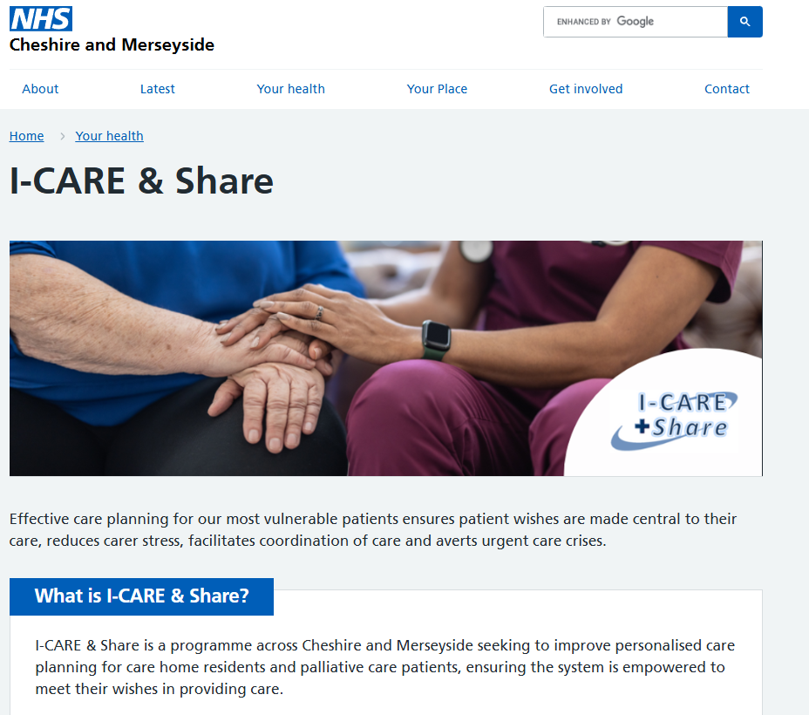
Use the website support site
https://www.cheshireandmerseyside.nhs.uk/your-health/i-care-share/

Slide 18
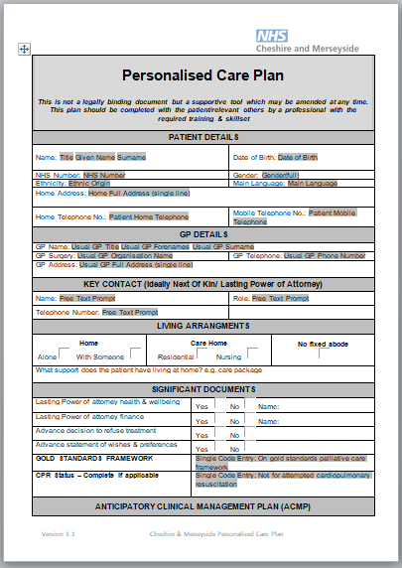
What about ReSPECT?
 | I-CARE & Share PCP | ReSPECT
DNACPR | NW uDNAR | ✓
Escalation thresholds | ✓ | ✓
Personal preferences | ✓ | ✓
Shareable | Word file | Word file
GP / Clinician contacts | ✓ | X
Suitable for PCN DES (CGA) | ✓ | X
Specifies significant docs | ✓ | X
Advance / Anticipatory Care Plan | ✓ | X
Baseline function | ✓ | X
Significant problems | ✓ | X
Codifies key data onto record | ✓ | X
Meets EPaCCs standards | ✓ | X
Success measurable through BI | ✓ | X

Slide 19
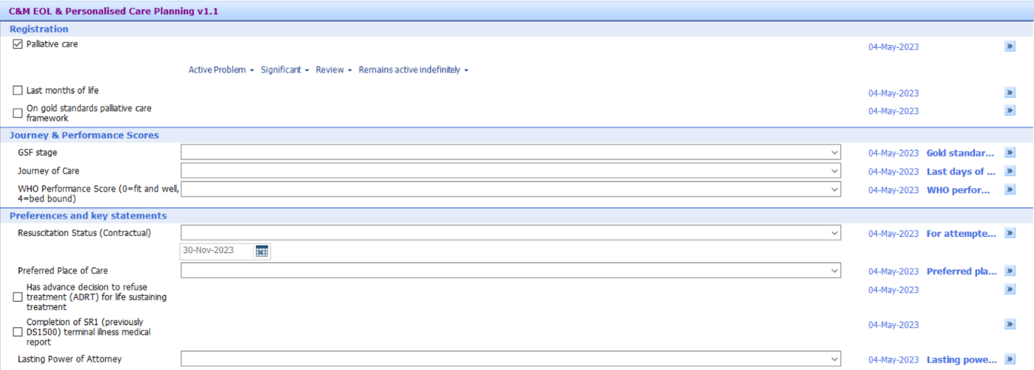
EMIS template

Slide 20
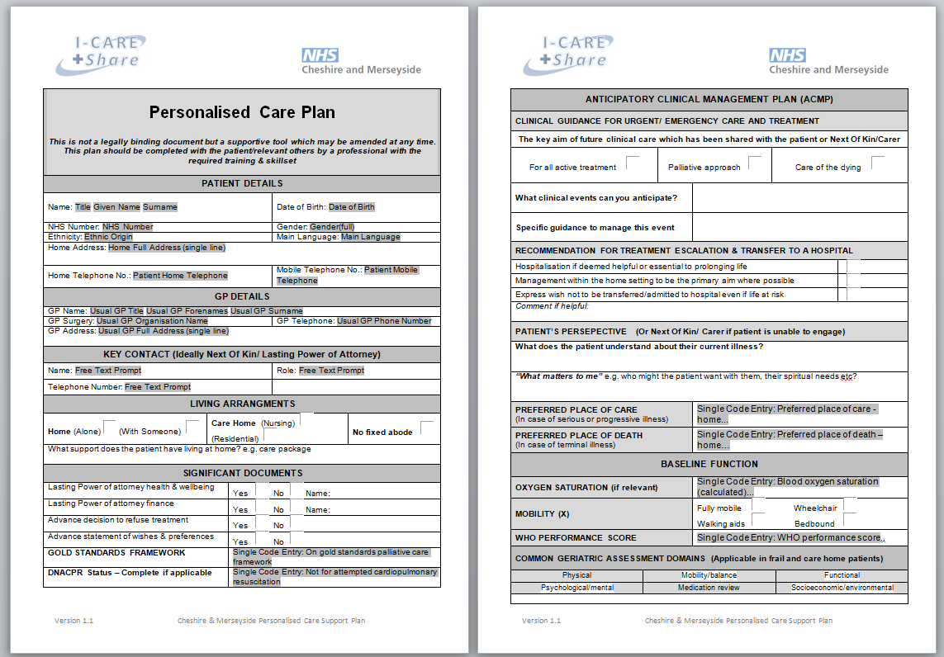
Personalised Care Plan v1.4

Slide 21
Internal GP IT Process for PCP:
End of Life
Patient in last months of life
Put on EOL register
Complete EMIS EOL template
PCP – Merged EMIS document
Register with OOH
Patient given printed copy
Coding feeds to BI & EPACCs
Identify
Register
Core coding
Collate
Share

Slide 22
Completing the PCP
Save the consultation
Re-open the consultation
Via ‘Documents’ find:
C&M I CARE & Share Personalised Care Plan v1.4. ewdt
Merged codes will be populated automatically
Complete other key patient specific variables
Save
Notify administration to share with patient & urgent care providers

Slide 23
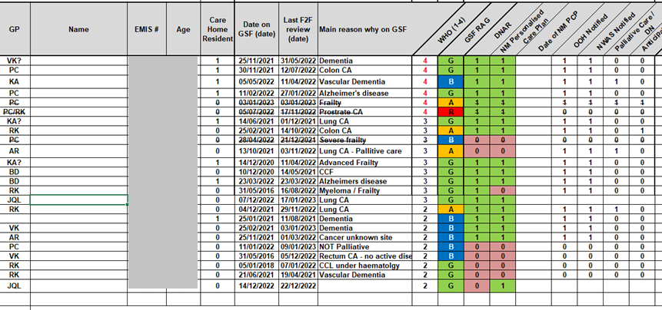
GSF tracker

Slide 24
Place Leads: Implementation
https://www.cheshireandmerseyside.nhs.uk/your-health/i-care-share/
Install the EMIS template(.xml) on GP EMIS systems
Install the PCP (.ewdt) document on GP EMIS systems
Local EOL lead: Test template and document on local GP system
Presentation to practice leads & PCN
Practices: Test template and document
Practices: Integrate into internal GSF processes
PCNs: Integrate into Care Home processes (DES)

Slide 25
References
Macmillan Advance Care Planning
https://www.macmillan.org.uk/coronavirus/healthcare-professionals/advance-care-planning
Anticipatory Care EOI - HEE
https://www.hee.nhs.uk/sites/default/files/Anticipatory%20Care%20EOI%20Form.docx
Anticipatory Care Planning Intervention for Older Adults at Risk of Functional Decline: A Primary Care Feasibility Study (Host Organisation – QUB)
https://research.hscni.net/chitin/trial/anticipatory-care-planning-acp
What is Advance Care Planning?
https://www.england.nhs.uk/north-west/north-west-coast-strategic-clinical-networks/our-networks/palliative-and-end-of-life-care/for-professionals/advance-care-planning/
EARLY Toolkit for Primary Care
https://www.england.nhs.uk/north-west/north-west-coast-strategic-clinical-networks/our-networks/palliative-and-end-of-life-care/for-professionals/early-toolkit-for-primary-care/
Electronic Palliative Care Coordinating Systems (EPaCCS)
https://www.england.nhs.uk/north-west/north-west-coast-strategic-clinical-networks/our-networks/palliative-and-end-of-life-care/for-professionals/electronic-palliative-care-coordinating-systems-epaccs/
Ambitions for Palliative and End of Life Care: A national framework for local action 2021-2026
https://acpopc.csp.org.uk/system/files/documents/2021-05/FINAL_Ambitions-for-Palliative-and-End-of-Life-Care_2nd_edition.pdf
Network Contract Direct Enhanced Service Draft Outline Service Specifications (pages 22-28)
https://www.engage.england.nhs.uk/survey/primary-care-networks-service-specifications/supporting_documents/Draft%20PCN%20Service%20Specifications%20December%202019.pdf
Supporting general practice, primary care networks and their teams through winter and beyond
https://www.england.nhs.uk/wp-content/uploads/2022/09/B1998-supporting-general-practice-pcn-and-teams-through-winter-and-beyond-sept-22.pdf

