Slide 1
Ulcerative Colitis
Education for healthcare providers
Prepared using Ulcerative colitis | Health topics A to Z | CKS | NICE

Slide 2

Who is affected?
The UK Crohn's & Colitis UK charity reports at least 1 in every 227 people in the UK has been diagnosed with ulcerative colitis. This amounts to around 296,000 people
The condition can develop at any age, but is most often diagnosed in people between 15 and 25 years old
It's more common in white people of European descent, especially those descended from Ashkenazi Jewish communities, and black people
The condition is rarer in people from Asian backgrounds, although the reasons for this are unclear
Both men and women seem to be equally affected by ulcerative colitis

Slide 3
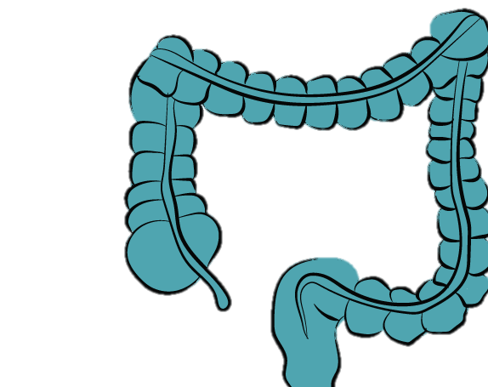
What is it?
Ulcerative colitis is a chronic, relapsing-remitting, non-infectious inflammatory disease of the gastrointestinal tract characterized by diffuse, continuous, superficial inflammation of the large bowel limited to the intestinal mucosa, and usually affects the rectum with a variable length of the colon involved proximally.

Slide 4


Underlying Causes
The exact pathophysiology is unknown, but it is thought to be an immune-mediated condition resulting in impaired epithelial barrier function and chronic inflammation caused by environmental triggers (such as changes in the gut microbiome) in genetically susceptible people
In about 5–15% of people, it is not possible to differentiate histologically between the Crohn's and UC

Slide 5
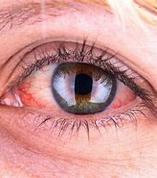
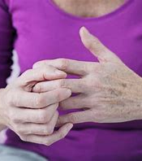
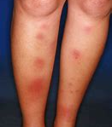
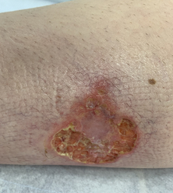
Manifestations
Ulcerative Colitis may have a number of extra-intestinal manifestations including :
Uveitis
inflammatory arthritis
erythema nodosum
pyoderma gangrenosum

Slide 6
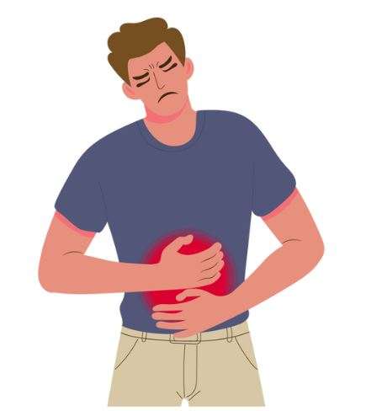
Possible complications:
negative psychosocial impact
toxic megacolon and bowel obstruction
anaemia
malnutrition
growth failure
colorectal cancer

Slide 7
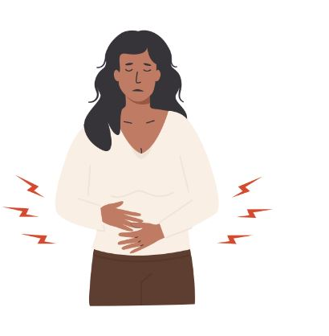
When to suspect Ulcerative Colitis
Bloody diarrhoea persisting for more than 6 weeks, or rectal bleeding, if malignancy is not suspected
Faecal urgency and/or incontinence
Nocturnal defecation
Tenesmus (a persistent, painful urge to pass stool even when the rectum is empty)
Abdominal pain, particularly in the left lower quadrant
Pre-defecation pain, which is relieved on passage of stool
Non-specific symptoms such as fatigue, malaise, anorexia, or fever (may suggest severe disease)
Weight loss, faltering growth, or delayed puberty in children
An associated family history of inflammatory bowel disease, coeliac disease, or colorectal cancer

Slide 8
Consider the following investigations
Serum full blood count — anaemia may be due to blood loss, malabsorption, or malnutrition; an increased platelet count may suggest active inflammation
Serum inflammatory markers such as C-reactive protein (CRP) and erythrocyte sedimentation rate (ESR) — may be raised if there is active inflammation or an infectious complication.
Serum urea and electrolytes — to assess for electrolyte disturbance and signs of dehydration.
Serum liver function tests, including albumin — a low serum albumin may indicate the presence of a protein-losing enteropathy, disease activity or severity, and nutritional status.
Thyroid function tests — to exclude hyperthyroidism
Serum ferritin, vitamin B₁₂, folate, and vitamin D levels — may indicate the presence of nutritional deficiencies due to malabsorption or intestinal losses.
Coeliac serology — to exclude coeliac disease
Stool microscopy and culture, including Clostridioides difficile toxin — to exclude infective gastroenteritis or pseudomembranous colitis. Note: the diagnosis of a pathogen does not exclude a diagnosis of ulcerative colitis, as a first episode may be triggered by enteric infection.
Faecal calprotectin if raised may suggest active inflammation (compared with a normal result which is expected in irritable bowel syndrome)
Additional tests if extra-intestinal manifestations such as pancreatitis, inflammatory arthritis, or primary sclerosing cholangitis are suspected, depending on clinical judgement.
Note: be aware that investigation results may be normal in a person with active ulcerative colitis.

Slide 9

Examination findings may include:
  Pallor, clubbing, or aphthous mouth ulcers.
  Abdominal distension, tenderness or mass, for example, in the left lower quadrant.
  Signs of malnutrition or malabsorption — serial weight loss or, in children, faltering growth or delayed puberty.
  Eye, skin, or joint signs of extra-intestinal manifestations
  Note: be aware that physical examination may be normal in people with mild or moderate disease

Slide 10
Differential Diagnoses
Crohn's disease
Infective colitis
Pseudomembranous colitis (Clostridioides difficile infection) Microscopic colitis — this typically presents with chronic watery diarrhoea in older people, and may be associated with the use of drugs, such as lansoprazole, aspirin, sertraline, ranitidine, and simvastatin.
Intestinal ischaemia — this typically presents with sudden-onset abdominal pain which is disproportionate to clinical findings, with possible signs of an acute abdomen (such as abdominal distension and guarding). Symptoms may be associated with eating. It occurs when colonic perfusion is impaired, for example, by mesenteric artery emboli, arterial or venous thrombosis, or vasculitis.
Diverticulitis
Coeliac disease
Irritable bowel syndrome
Anal fissure
Malignancy, such as colorectal cancer
Endometriosis
Laxative misuse

Slide 11

What might be included in a Primary Care Review
  Assessing the impact of symptoms on daily functioning
  Assess for associated anxiety and/or depression
  Offering sources of information and support, including advice on contraception if needed.
  Assessing the person's risk of osteoporosis, and managing appropriately.
  Ensure the person is aware of the need for colorectal cancer surveillance, and has colonoscopy screening arranged by the specialist team if diagnosed 10 years ago or more (with the exception of those with confirmed proctitis alone). The frequency of subsequent monitoring is a specialist decision, depending on the severity and duration of colitis, presence of co-morbid conditions, and the appearance at colonoscopy.
  Prescribing and monitoring specialist drug treatments if a shared-care agreement is in place, and encouraging adherence to treatment.
  Assessing for clinical features suggesting a flare-up or other troublesome symptoms, and managing appropriately.
  Encourage healthy lifestyle measures, including maintaining a healthy weight and taking regular exercise if possible
  Ensuring the person receives appropriate vaccinations. Advise that if the person is taking immunosuppressive or biologic medication live vaccines are contraindicated, and these vaccines should only be given before the start of specialist treatment, or else postponed for at least 6 months after stopping this therapy.
  Advising of the need to be referred to a gastroenterologist for treatment review if planning a pregnancy and ensuring optimal disease control during pregnancy under joint gastroenterology and obstetric supervision.
Complications | Background information | Ulcerative colitis | CKS | NICE

Slide 12
Specialist Treatment
Aminosalicylates — mesalazine and sulfasalazine may be considered for a mild-to-moderate first presentation or inflammatory exacerbation of ulcerative colitis. These drugs are also effective at maintaining remission. They are often prescribed topically (suppository or enema) initially, and orally if remission is not achieved. For extensive disease, topical and high-dose oral treatment may be offered first-line
Corticosteroids — monotherapy with a time-limited course of corticosteroids may be used for induction of remission if aminosalicylates are ineffective or not tolerated, with the aim to gradually taper the dose according to disease severity and the person's response to treatment. They should not be used to maintain clinical remission due to the risk of multiple adverse effects with long-term use. They may be prescribed topically, orally, or intravenously
Ciclosporin — may be used for acute severe disease, especially if intravenous corticosteroids are not effective, contraindicated, or not tolerated
Thiopurines — azathioprine or mercaptopurine may be considered to maintain remission in people using aminosalicylates who have required two or more courses of oral corticosteroids in the previous year or whose disease is steroid refractive or dependent.
*Note: thiopurines may increase the risk of non-melanoma skin cancer, and people should be monitored for skin cancer and given appropriate sun protection advice
Biologics and Janus kinase inhibitors — infliximab, adalimumab, golimumab, tofacitinib, ustekinumab, vedolizumab, filgotinib, and mirikizumab are used to induce or maintain remission in people with severe active disease in specific scenarios such as when conventional or other therapies are not working or not tolerated. The sphingosine-1-phosphate receptor modulator ozanimod is also an option.

Slide 13
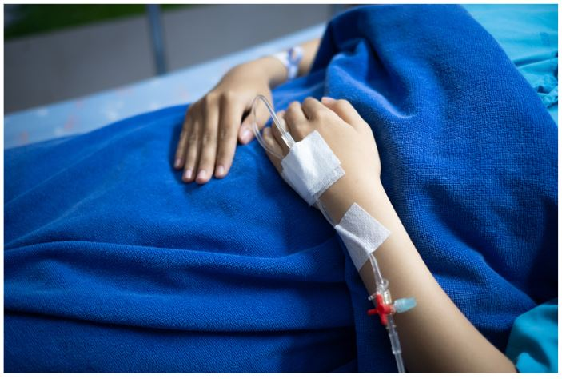
Management of flare-ups
Arrange an emergency hospital admission if the person has a suspected flare-up of ulcerative colitis with:
  Severe diarrhoea, nocturnal diarrhoea, or bloody diarrhoea (more than 6–8 stools a day).
  Fever, dehydration, tachycardia, or hypotension.
  Severe abdominal pain or suspected intestinal obstruction
  Signs of malnutrition with a body mass index (BMI) less than 18.5 kg/m2, or unintended sudden weight loss.
  Raised inflammatory markers and/or anaemia.
  Persistent symptoms despite optimal management in primary care.

Slide 14
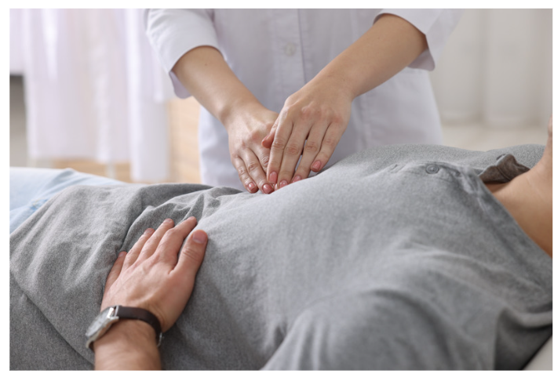
If admission to hospital is not needed
Consider whether symptoms may be due to an alternative condition such as Clostridioides difficile infection, and manage appropriately.
Check the person's adherence to their current drug treatment regimen and encourage them to take medication regularly and appropriately.
Consider arranging an urgent specialist gastroenterology review appointment or seeking specialist advice.
Consider prescribing drug treatment for disease flare-ups according to the person's shared-care agreement, such as starting a time-limited course of oral corticosteroids, if appropriate, whilst awaiting specialist review. Corticosteroids should not be used to maintain disease remission. Do not prescribe nonsteroidal anti-inflammatory drugs (NSAIDs) if there is suspected acute severe colitis.
Consider arranging a referral to a dietitian if there are signs of unintended weight loss or malnutrition.
If there are recurrent flares of disease activity, seek specialist advice regarding whether the person's maintenance treatment regimen needs to be changed to improve disease control, or whether surgery may be needed.

Slide 15
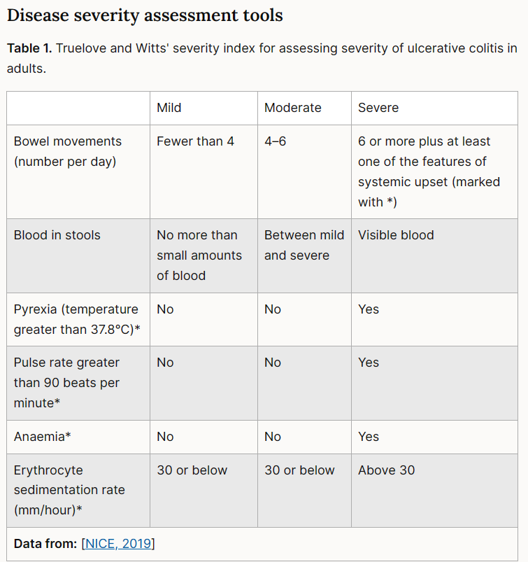
Disease severity assessment tools

Slide 16





Diarrhoea
  Exclude any alternative cause for diarrhoea symptoms, such as infection, abscess, dysmotility, bacterial overgrowth, or bile salt malabsorption (typically causes watery diarrhoea accompanied by abdominal bloating and steatorrhoea)and manage appropriately.
  Diarrhoea may be secondary to drug treatment, including laxatives, iron supplements, antibiotics, azathioprine, mercaptopurine, or methotrexate. Seek specialist advice regarding reducing or stopping medication, if necessary.
  Do not prescribe anti-motility drugs such as loperamide (unless advised by a specialist) as they do not usually reduce stool frequency and can increase the risk of toxic megacolon.
  Offer sources of information about symptom management, such as the Crohn's and Colitis UK patient information sheets Diarrhoea and constipation, Managing bowel incontinence in IBD, and Bloating and wind.
diarrhoea-and-constipation.pdf
Differential diagnosis | Diagnosis | Ulcerative colitis | CKS | NICE
managing-bowel-incontinence-in-IBD.pdf
Complications | Background information | Ulcerative colitis | CKS | NICE
Bloating-and-Wind.pdf

Slide 17


Constipation
  Assess for bowel obstruction as an underlying cause, and if suspected, arrange emergency hospital admission.
  If bowel obstruction is unlikely, ensure that the diet includes adequate fluid and soluble fibre, and warn that soluble fibre sometimes increases bloating and distension
  Offer sources of information about symptom management, such as the Crohn's and Colitis UK patient information sheet Diarrhoea and constipation and booklet Food. Your guide.
  If symptoms persist despite dietary advice, consider offering a bulk-forming laxative, such as ispaghula husk, methylcellulose, or sterculia (all soluble fibre products). Do not prescribe other types of laxatives.
  Seek specialist gastroenterology advice if these measures are ineffective.
diarrhoea-and-constipation.pdf
Food.pdf
Complications | Background information | Ulcerative colitis | CKS | NICE

Slide 18


Abdominal pain
  Identify the underlying cause of abdominal pain if possible, to allow appropriate management.
  Persistent or recurrent abdominal pain is common in ulcerative colitis and may be caused by inflammatory exacerbations and poor disease control, intestinal dilatation, bowel obstruction, or rarely, adhesions.
  Offer analgesia for symptom relief. See the CKS topic on Analgesia - mild-to-moderate pain for more information
  Consider paracetamol first-line.
  Avoid nonsteroidal anti-inflammatory drugs (NSAIDs) as they may aggravate colitis symptoms.
  Be aware that opiate analgesia may increase the risk of developing toxic megacolon.
Analgesia - mild-to-moderate pain | Health topics A to Z | CKS | NICE
Complications | Background information | Ulcerative colitis | CKS | NICE

Slide 19
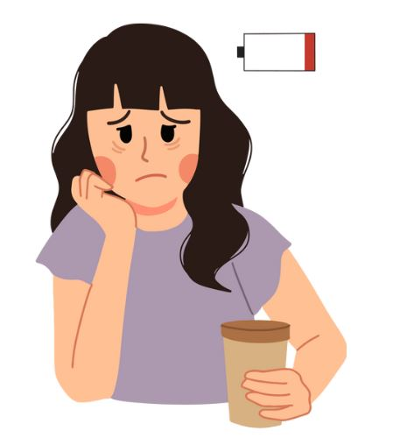
Fatigue
  Exclude any alternative or contributing cause for persistent fatigue, in addition to active disease, and manage appropriately.
  Additional causes include pain, anaemia, reduced nutritional intake and activity levels, sleep disturbance, stress, anxiety, and depression.
  Consider checking serum full blood count, ferritin, vitamin B12 and folate levels, as people with ulcerative colitis can develop iron deficiency anaemia due to blood loss or decreased absorption; anaemia of chronic disease; anaemia secondary to nutritional deficiencies; or drug-induced anaemia secondary to use of mercaptopurine, azathioprine, or sulfasalazine, for example. Be aware that the optimal management of anaemia of chronic disease involves induction of remission of ulcerative colitis.

Slide 20

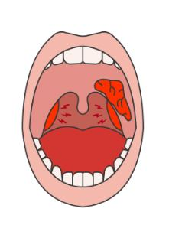
Oral problems
If the person develops suspected oral lesions secondary to ulcerative colitis, such as persistent aphthous ulcers, arrange referral to a specialist in oral medicine, depending on clinical judgement. See the CKS topic on Aphthous ulcer for more information.
Aphthous ulcer | Health topics A to Z | CKS | NICE

Slide 21



Contraception advice
  Women with ulcerative colitis should avoid unplanned pregnancy to ensure that disease management and drug treatments are optimised prior to conception.
  For women with ulcerative colitis, the choice of contraceptive method may be influenced by factors such as malabsorption, surgical history, prolonged immobility, extra-intestinal manifestations such as primary sclerosing cholangitis, and associated conditions such as osteoporosis and venous thromboembolism.
  See the CKS topic on Contraception - assessment for detailed information on contraception options for women with different co-morbidities.
  See the Faculty of Sexual and Reproductive Healthcare (FSRH) guideline UK Medical Eligibility Criteria for Contraceptive Use (UKMEC) for detailed information on prescribing contraception for people with inflammatory bowel disease.
  Oral methods may be less reliable if there is significant malabsorption or history of small bowel resection. Oral methods are unaffected by colectomy and ileostomy.
  Be aware that the manufacturers advise the use of effective contraception during treatment, and for at least:
  6 months after treatment of either partner with methotrexate (not commonly used for ulcerative colitis) and 3 months after treatment with mercaptopurine.
  6 months after maternal treatment with anti-tumour necrosis factor (TNF)-alpha monoclonal antibody agents (such as infliximab or adalimumab).
  Offer sources of support and information, such as the Crohn's and Colitis UK patient information leaflet Reproductive health.
Contraception - assessment | Health topics A to Z | CKS | NICE
UKMEC April 2016 (Amended September 2019) FSRH
Reproductive health and fertility in Crohn's Disease or Ulcerative Colitis (IBD)

Slide 22




Fertility advice
  Advise women with ulcerative colitis that:
    Active disease may affect fertility.
    Those who have a history of abdominal or pelvic sepsis, surgery, or adhesions, may be at increased risk of impaired tubal function.
    See the CKS topic on Infertility for more information.
  Advise men with ulcerative colitis that:
    Fertility is unlikely to be affected for most men, however, a history of pelvic surgery may lead to erectile dysfunction or ejaculatory problems. In addition, men who undergo ileo-anal pouch surgery may develop retrograde ejaculation and erectile dysfunction. See the CKS topic on Erectile dysfunction for more information.
    Drug treatment with sulfasalazine or methotrexate may cause reversible oligospermia. Infliximab treatment may affect semen quality by reducing motility in some men.
  Offer sources of support and information, such as the Crohn's and Colitis UK patient information leaflet Reproductive health and IBD.
Infertility | Health topics A to Z | CKS | NICE
Reproductive_Health.pdf
Erectile dysfunction | Health topics A to Z | CKS | NICE

Slide 23


Pre-pregnancy planning
  Refer women and men with ulcerative colitis who are planning a pregnancy to a gastroenterologist for pre-conception counselling and medication review. See the CKS topic on Pre-conception - advice and management for more information.
    For women, specialist drug treatment may need to be changed, as some medications are considered safer in pregnancy than others. Ulcerative colitis management should be optimized by the specialist, to ensure that the disease is well controlled and in remission before trying to conceive. This reduces the risk of persistent disease activity and relapse during pregnancy.
    For men, drug treatments that affect spermatogenesis may need to be changed.
Pre-conception - advice and management | Health topics A to Z | CKS | NICE

Slide 24
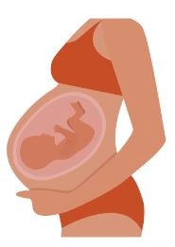



Pregnancy advice
  If a woman has a planned pregnancy, ensure she is jointly managed by a gastroenterologist and obstetrician with appropriate expertise.
  If a woman has an unplanned pregnancy and she or her partner is prescribed:
    Methotrexate (not commonly used for UC), mercaptopurine, infliximab, or adalimumab — seek immediate specialist advice from a gastroenterologist and/or a specialist in fetal medicine about whether treatment needs to be altered, and the need for folic acid supplementation. See the section on Fertility issues for more information.
    Other medication — arrange an urgent specialist gastroenterology review to ensure optimal management of ulcerative colitis and advise the woman to continue maintenance drug treatment and start folic acid supplementation.
  Advise that if a woman has had significant pelvic surgery or active rectal involvement, she may be offered elective Caesarean section to reduce the risk of potential anal sphincter damage.
  Offer sources of support and information:
    Crohn's and Colitis UK offers a patient information leaflet on Pregnancy and IBD.
    Patient leaflets about the use of medicines to treat UC in pregnancy are freely available from the UK Teratology Information Service (www.uktis.org)
Scenario: Fertility, pregnancy, and breastfeeding with ulcerative colitis | Management | Ulcerative colitis | CKS | NICE
Pregnancy and breastfeeding with Crohn's Disease or Ulcerative Colitis (IBD)
UKTIS – Evidence-based safety information about medication, vaccine, chemical and radiological exposures in pregnancy

Slide 25
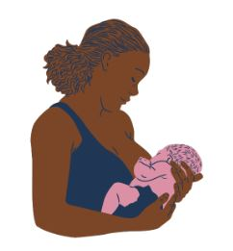



Breastfeeding advice
  If a woman with ulcerative colitis wishes to breastfeed, seek specialist gastroenterology advice if there is any uncertainty about the safety of breastfeeding while taking specialist medication.
  If a woman experiences problems breastfeeding, see the CKS topics on Breastfeeding problems and Mastitis and breast abscess for more information.
  Advise women that the risk of a flare-up of disease may be increased post-partum.
Breastfeeding problems | Health topics A to Z | CKS | NICE
Mastitis and breast abscess | Health topics A to Z | CKS | NICE
Scenario: Confirmed ulcerative colitis | Management | Ulcerative colitis | CKS | NICE

Slide 26
In summary
Ulcerative colitis is a chronic, relapsing-remitting, non-infectious inflammatory disease of the gastrointestinal tract characterized by diffuse, continuous, superficial inflammation of the large bowel limited to the intestinal mucosa, and usually affects the rectum with a variable length of the colon involved proximally
It requires multifaceted, multidisciplinary holistic shared care between primary and secondary care

Slide 27
Resources
Crohn's and Colitis UK is a national charity that provides support for people with ulcerative colitis and their families (website available at www.crohnsandcolitis.org.uk; telephone information service and emotional support helpline 0300 2225700). It publishes a range of information sheets and booklets including Ulcerative colitis. Your guide and IBD in children: a parent's guide, and provides information on managing symptoms, drug treatments, diet, pregnancy, education, employment, and travel.
CICRA (Crohn's in Childhood Research Association) is a national charity that supports children and young people with inflammatory bowel disease (website available at www.cicra.org), and provides patient information and young people's forums for peer support.

