Slide 1
Is the Patient Fit for Bowel Prep at Home?
Guide to referrers completing lower GI referral forms

Slide 2
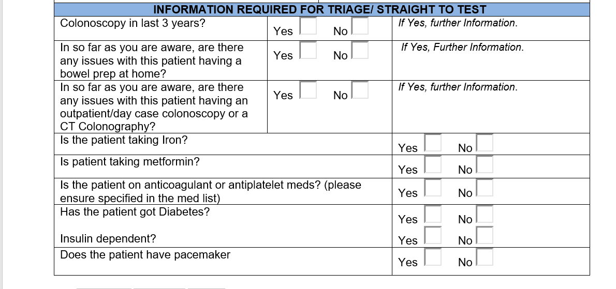
Excerpt from lower GI referral form

Slide 3

What does Bowel prep for colonoscopy involve?
In Cheshire and Merseyside –Plenvue, or Moviprep
Both are Polyethylene glycol electrolyte solutions.
Work as osmotic laxatives. Diarrhoea is the expected effect
Involves several litres of fluid intake over hours before procedure.
Also requires being able to comply with dietary instructions (vary depending on morning or afternoon procedure)
Requires accessible toilet facilities and ability to mobilise to this.

Slide 4

Contraindications to bowel prep are few
For all preparations:
  Hypersensitivity to the active substances or to any of the excipients
  Gastrointestinal obstruction or perforation
  Disorders of gastric emptying (e.g. gastroparesis)
  Ileus
  Toxic megacolon, which complicates very severe inflammatory conditions of the intestinal tract including Crohn's disease and ulcerative colitis.
Moviprep specifically:
  Phenylketonuria (due to presence of aspartame)
  Glucose-6-phosphate dehydrogenase deficiency (due to presence of ascorbate)

Slide 5
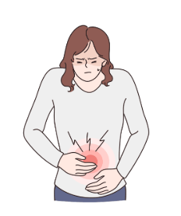
Other cautions/considerations
Impaired gag reflex, or with a tendency to aspiration or regurgitation
Impaired consciousness
Severe renal insufficiency (creatinine clearance <30 mL/min)
Cardiac impairment (NYHA grade III or IV)
Those at risk of arrhythmia, for example those on treatment for cardiovascular disease or who have thyroid disease
Dehydration
Severe acute inflammatory bowel disease
The presence of dehydration should be corrected before the use of any of the preparations

Slide 6

What are the options if the patient is not fit for Bowel Prep at home?
There are few indications for inpatient bowel prep – i.e if pt is not fit for bowel prep at home they are unlikely to be fit for bowel prep in hospital. There may be some exceptions to this, such as alternate feeding means.
CT colonoscopy – accepted as the best radiological means of identifying colorectal cancer and advanced colonic polyps.
A high resolution CT typically performed in prone and supine positions, requiring some pre-procedure bowel preparation and peri-procedure colonic insufflation.
CT Colon can be lower perforation risk, more acceptable for patient, and require reduced pre-procedure bowel prep.
CT Colon not suitable if small polyps are likely to be of significant, for example in lynch syndrome.
Minimal preparation CT Colonoscopy (MPCT) without colonic insufflation might be appropriate if the intention is to identify large lesions only and patient may not be suitable for full prep and colonic insufflation.
From Royal college radiology guidance.

Slide 7
Key messages
Adequate bowel preparation is essential for identifying significant lesions on colonoscopy
There are few contraindications to the bowel preparations in use in C&M
If there are cautions, especially those which may also be relevant to treatment of any identified lesion, radiology imaging in the form of CT colonoscopy may be more appropriate.
Supplying the colorectal/lower GI triage team with the information needed to assess this can allow the patient to proceed to the optimal test without delay
Understand standard bowel prep can help prepare patients and/or carers to make decisions about what might be right for them

Slide 8
References
Lebwohl B, Kastrinos F, Glick M, et al. The impact of suboptimal bowel preparation on adenoma miss rates and the factors associated with early repeat colonoscopy. Gastrointest Endosc 2011;73(6):1207-14. doi: 10.1016/j.gie.2011.01.051 [published Online First: 2011/04/08]
From above article – 24% sub optimal prep
extension://efaidnbmnnnibpcajpcglclefindmkaj/https://www.healthylondon.org/wp-content/uploads/2017/11/Pan-London-Suspected-Cancer-Referral-Guide-Upper-GI.pdf
Bowel Preparation Quality: How to Get Perfect Bowel Preparation for Every Patient - Gastroenterology & Endoscopy News (gastroendonews.com)
Colonoscopy prep not working: What happens next (medicalnewstoday.com)
Guidance on the use of CT colonography for suspected colorectal cancer | The Royal College of Radiologists (rcr.ac.uk)

