Slide 1


Elective Recovery
CMAST Programme Update
Mid Year – Annual Plan Delivery
26th October 2024

Slide 2
Elective Recovery Annual Plan Goals
Goal 1: Waiting Lists Management & Elective Recovery
Reducing long waits
Restoring activity levels
Goal 3: Reducing Variation in Care
Levelling waiting times across C&M
Mutual aid and shared resources
Goal 2: System Productivity & Resources
ERF delivery
Theatre utilisation
Elective hubs and cold site utilisation

Slide 3






We have managed a comprehensive programme
Waiting List Management
Risk stratification & cohorting
Waiting list validation & best practice
Prioritisation and reducing clinical risk of surgery
Identifying patients for HVLC pathways
Cohorting patients for elective hubs / mutual aid
Waiting well and prehabilitation
Reducing risk of decompensation while waiting
Supporting lifestyle changes to reduce clinical risk of surgery
Prehabilitation advice and support
Fitness for surgery
Maximising local capacity
4 elective hubs being mobilised
Mutual aid hub
Shared approach to PTL to reduce variation in WL
Focus on reducing 65 weeks and 52
GIRFT pathways and top decile
Local capacity as priority at peak times
Provider productivity
Top decile provider performance
Theatres improvement
Elective hub usage
Reduction in capacity-related insourcing and outsourcing
GIRFT pathways & HVLC lists
Mutual aid and partnerships
OP improvement
Digital innovation & system working
Shared PTL concepts and mutual aid
Patient Engagement Portals
Advice and guidance pathways
Digital appointments
Group consultations

Slide 4

We have been reduced the long waits dramatically
We have sustained our zero 104 week wait position since March 2022
78 weeks has been a massive challenge. As of end of October we were reporting 47 patients waiting over 78 weeks. Only 8 of these were capacity breaches, with the others reported as patient choice or clinically complex.
As of end of October 1,132 patients were waiting 65 weeks, with 6,524 needing to be cleared by the end of December deadline. This number is decreasing week by week, as our clearance rate for 65 weeks remains around 1,400 per week.
We are working on clearing the backlog of 52 week waiters, and have 84,730 to clear before the end of March, and our clearance rate for this cohort is over 6,000 per week.
This time last year our total waiting list was 404,042 patients. Now it is 382,399, so we are reducing the overall waiting list in real time, despite the growth in referrals, and reducing the waiting list.

Slide 5
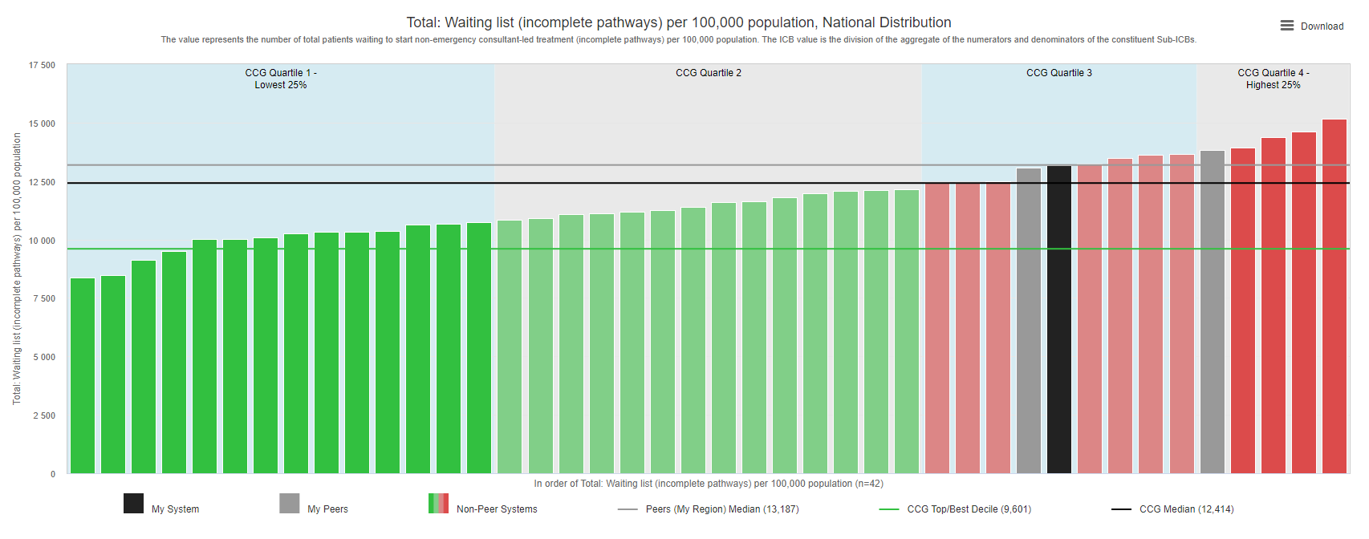
And to put this in context, we have one of the biggest challenges in the country

Slide 6
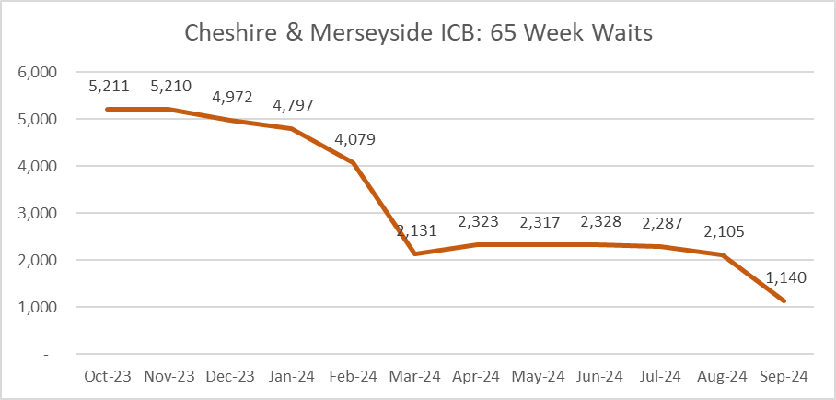
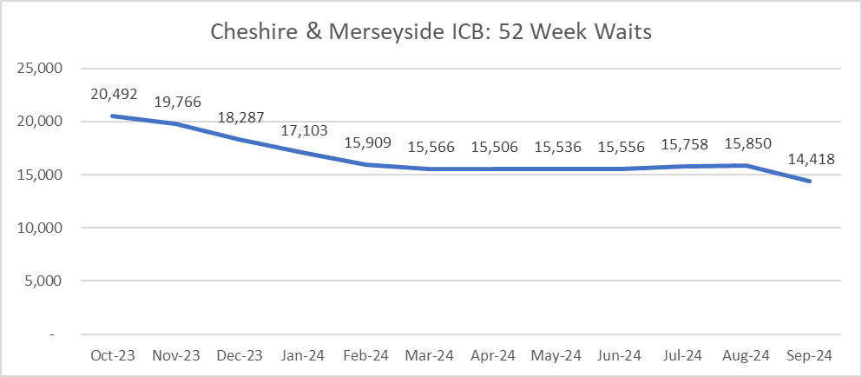
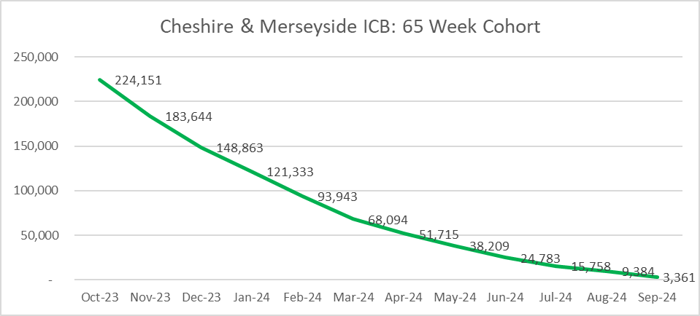
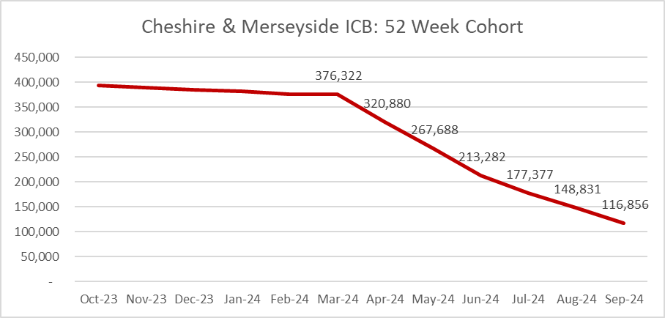
Elective Waiting Time Restoration (September)
Notes:
6

Slide 7
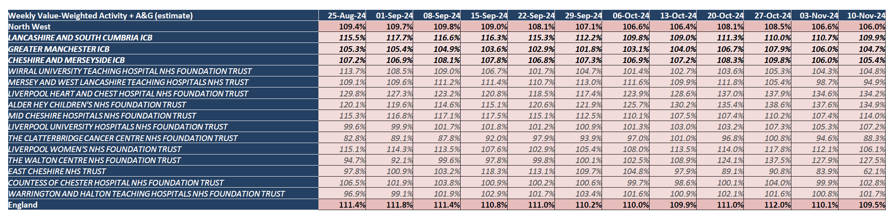
We are performing well against the ERF target of 104.7%
The Elective Recovery Fund (ERF) was set up to fund additional activity in restoring waiting lists. Each system has a target based on comparison with the 19/20 baseline. For us the target is 104.7%.
These indicative figures show we have achieved over 104.7% consistently.
The published figures which include any adjustments and additions are usually higher

Slide 8
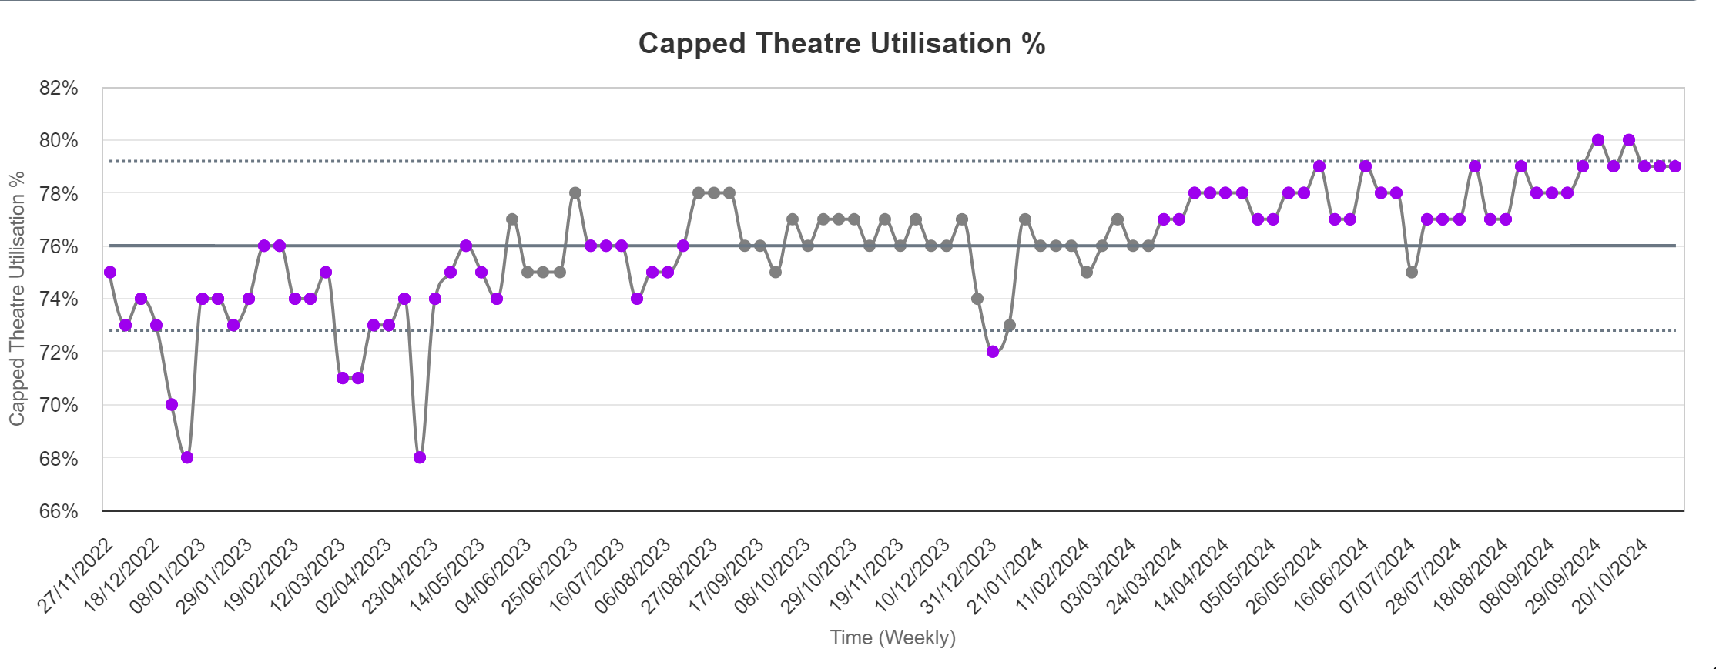
We are achieving the 80% theatre utilisation target, and still have opportunities…
When you look over time you can see that since November 2022 when we launched our theatre productivity programme we have improved our trend consistently.
Our uncapped utilisation is meeting the target at around 83%, which includes overruns and early starts.

Slide 9
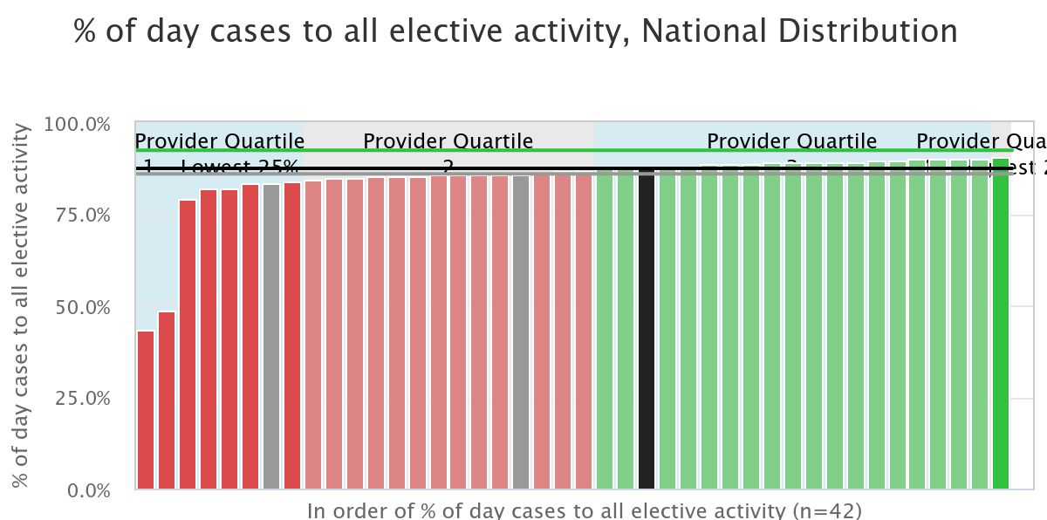
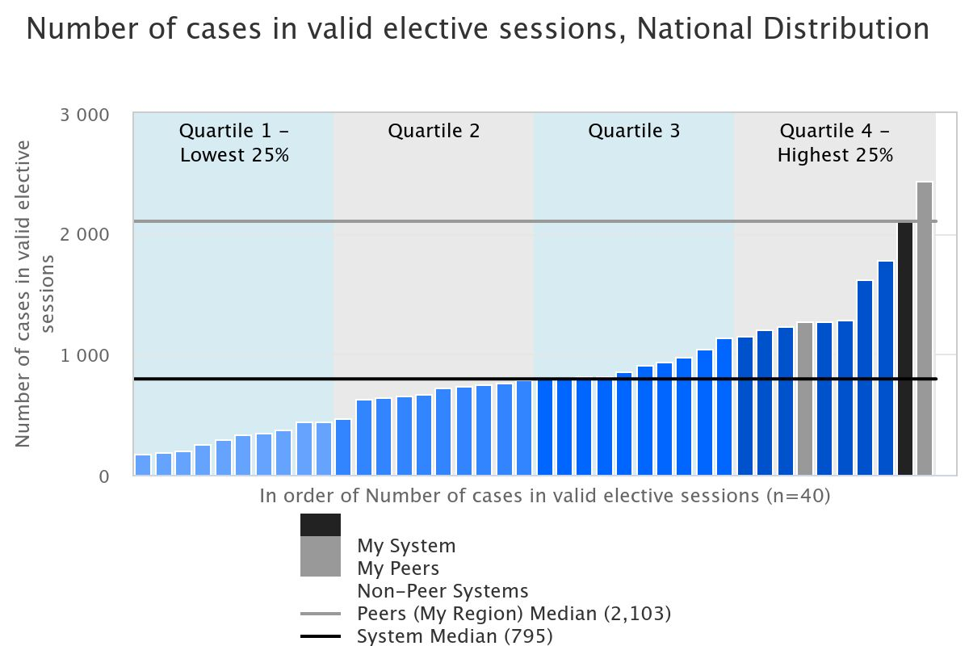
We have also performed well against some of the other productivity metrics
There are several metrics where we perform well, and in some, we are leading the way. For example % day cases, cases in valid elective sessions, and BADS inpatients converted to day cases.

Slide 10
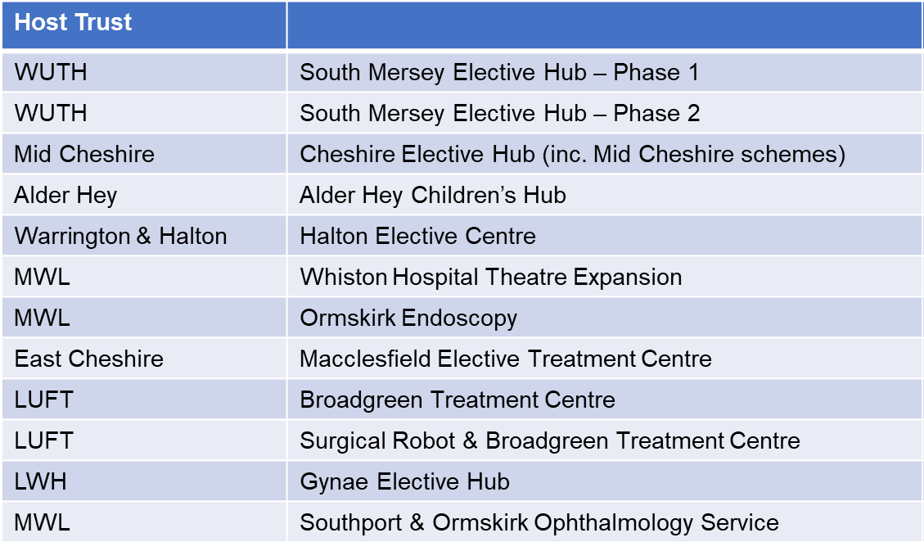
We have managed a capital investment programme of £76m
The TIF (Targeted Investment Fund – the national elective capital investment programme) has been a 3 year programme delivering a range of schemes to improve flow for elective care pathways.

Slide 11
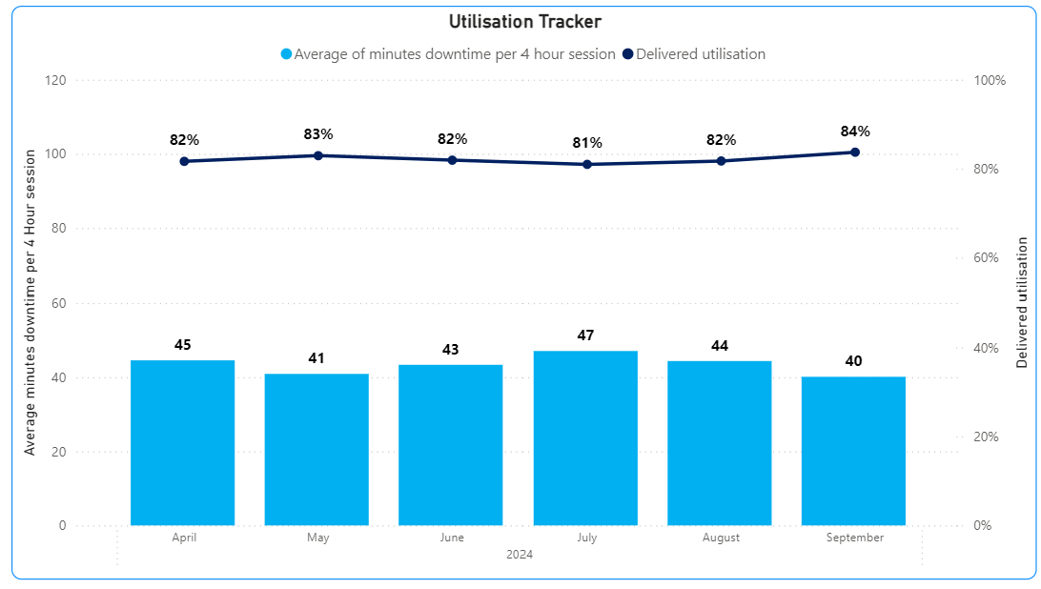
Our TIF has enabled us to develop an effective surgical hubs network
We have four established elective hubs that are cold sites, and able to support system-wide surgical pathways.
We have two more that are coming online within the next 18 months.
We have established an elective hubs working group that facilitates conversations around shared pathways and new ways of working. This group links directly with the mutual aid group to take a shared approach to our most challenging specialties.
Since the working group was established, we’ve seen the following improvements in the C&M Surgical Centre:
5% improvement in uncapped utilisation (includes overruns and early starts) since April 2024
4% improvement in capped utilisation since April 2024
1,417 patients contacted to offer slots at the centre

Slide 12
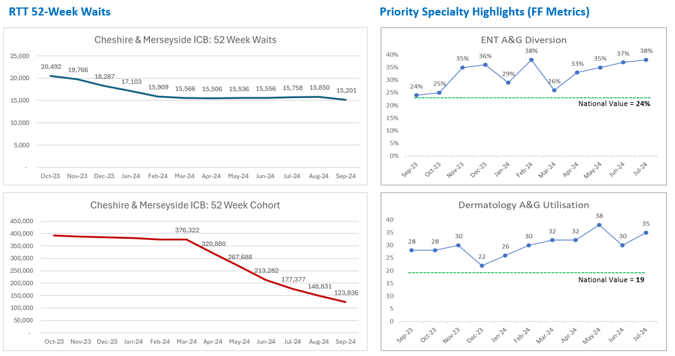
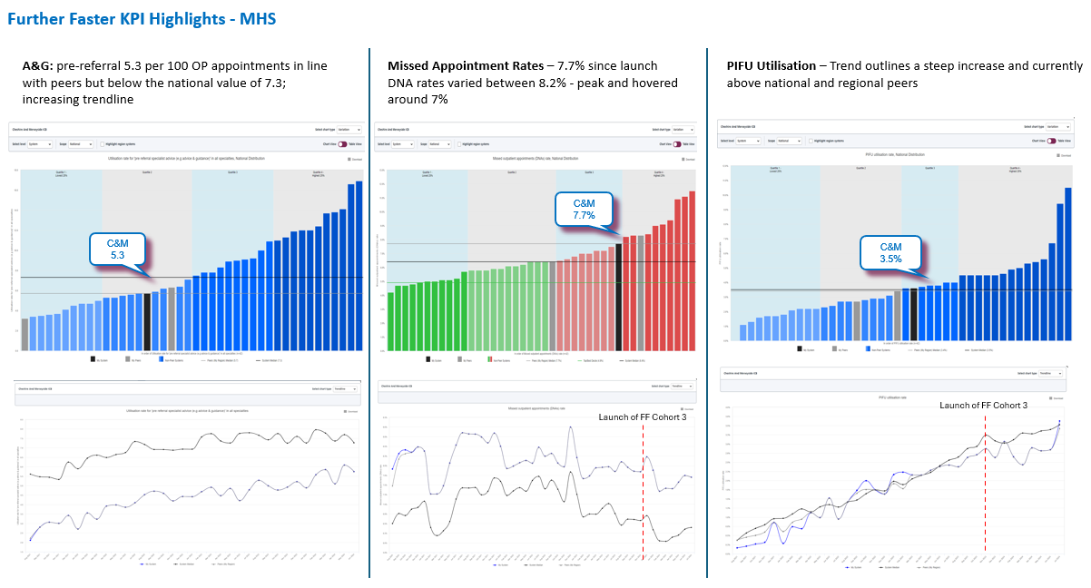
Our Further Faster Programme has delivered some great outcomes

Slide 13
We’ve already avoided over 170,000 outpatient appointments so far this year…
We have made excellent progress with implementing specialist advice and patient-initiated follow-up (PIFU) services last year. More than 90% of outpatient departments across C&M are now offering patients specialist advice and PIFU pathways in 14 priority specialities.
Specialist advice
315,235 specialist advice requests processed (YTD from 1st Jan to 30th Sept).
This prevented 60,050 new outpatient hospital appointments so far.
The majority of specialist advice requests were responded to within 48 hours so patients are receiving specialist care quickly, in the community without having to attend hospital.
Patient initiated follow up
114,470 patients joined PIFU pathways so far this year.
This has prevented those patients having unnecessary follow up appointments.
This is enabling patients to be seen at a time that suits them and their clinical need and is creating capacity for clinicians to see patients who really need appointments.

Slide 14
Our mutual aid hub has been focussing on levelling out our waiting lists
We have a small team facilitating the PTL management and mutual aid requests. The team have now facilitated nearly 15,000 patient moves between providers to help level out the waiting lists.
In addition the team led the national “Patient Initiated Digital Mutual Aid System” (PIDMAS) initiative to invite patients waiting over 40 weeks to request an alternative provider. The team have received national recognition as exemplars for the roll out of the PIDMAS programme.
8,254
250
6,050
14,554
Mutual aid requests filled and patients placed
PIDMAS moves
Insourcing / outsourcing mutual aid events
Total mutual aid facilitated moves

Slide 15
Additional schemes in place to reduce variation in care
Variation between provider waiting times has reduced so there is more consistency between wait times across our geography (last year we reduced from 34 weeks difference to just 15 weeks for surgery, and from 36 weeks difference to 8 for the OP pathways).
Patient choice initiatives including development of better ESR methods, management of insourcing and outsourcing to ensure optimal patient choice processes, better visibility of wait times between providers
Continued commitment to PIDMAS cohorts, to ensure those who had opted for alternative providers are given choice where available
Development of a single, standardised access policy that sets out equitable waiting list management methodologies
Work on development of a single PTL for certain cohorts
Video group consultations to support faster appointments and build connections and support between patients

