Slide 1


CMAST 24/25 Planning
6-month review
Efficiency at Scale
Date: November 2024
Presented by: Nina Russell

Slide 2
E@S Key Deliverable 24/25
Procurement
Medicines Optimisation
Governance & Risk
Legal
HR & Payroll
Digital & Estates
On track to deliver the annual C&M wide procurement plan
Implementation of 2 value based procurement schemes
Optimisation of two national contracts:
Energy
Mobile phones
On track to deliver the annual C&M wide procurement plan
Implementation of 2 value based procurement schemes
Optimisation of two national contracts:
Energy
Mobile phones
QIPP Plan has delivered £7.6m & is being closely monitored via recovery board. Capacity challenges continue but mitigations in place.
C&M has secured £1m of additional from NHSE for Homecare services
Joint NHSE/C&M High Cost Drug (HCD) scheme due to commence in H2
Liverpool Legal collaboration has commenced
Infection Prevention & Control network in place & C Diff tool kits in development
National NHSE team have recognised additional indemnity insurances as a priority
E@S programme is working with HRDs on an occupation health workstream
C&M payroll workstream has commenced and clear workplan and timescales established
Digital and estates category deep-dives completed
Each has selected three priority areas to move forward with
National mobile phone contract delivered £2.3m FYE savings
C&M wide transport review commencing
Target 24/25 - £7.1m
Delivered H1 - £5.4m
Target QIPP 24/25 £21m
Delivered QIPP H1 £7.6m
Target HCD £9.1 FYE
Starting from H2
Target 24/25 - £0m
Delivered H1 - £0.6m
Consolidate and analysis 23/24 corporate benchmarking data

Slide 3
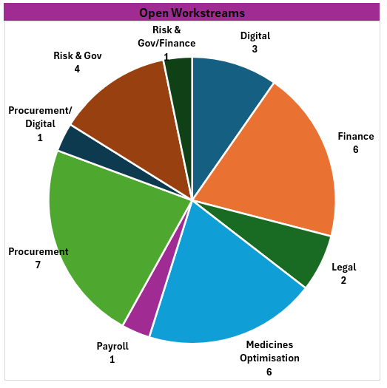
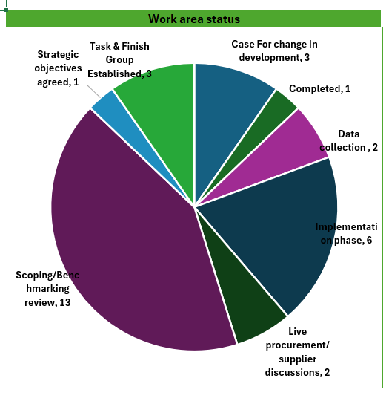
Active E@S workstreams

Slide 4



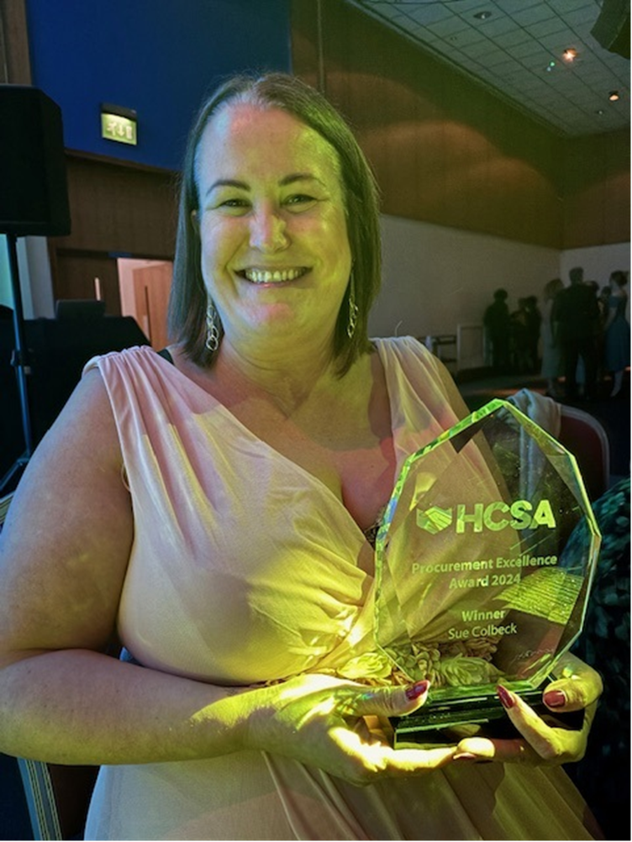
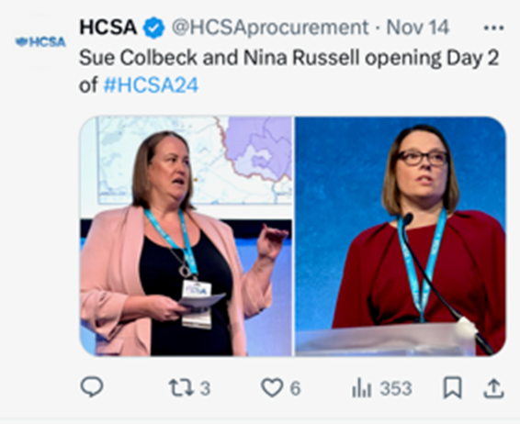
Other Key achievements 24/25
C&M Benchmarking Review
All Trusts completed national return
System integration data packs produced for Cheshire, Liverpool, Warrington & Wirral
23/24 data analysis commenced, and high-level feedback given to CEOs & DoFs
£300k recurrent funding for E@S programme via ICB confirmed from 25/26

Slide 5

E@S Programme – lessons learned
Capacity challenges within the E@S programme which has limited the number of workstreams.
Long term sustainability of E@S programme as funding non recurrent.
Medicines transformation funding (£450k) non recurrent
Funding limitations for transformation opportunities
Not all opportunities are possible/appropriate at a C&M level
Limitations and risks within primary care in relation to medicines optimisation QIPP
Secured additional resource
Recurrent funding for E@S programme secured via the ICB from 25/26 - £300k
Recurrent medicines transformation funding secured via the ICB from 25/26 - £450k.
Working with several external partners using various models to limit up front cost relating to efficiency opportunities
Utilisation of national /regional funding opportunities where possible.
Produced data pack for the integration workstreams to identify sub-regional opportunities
Additional QIPP opportunities have been identified
Complete 23/24 Data analysis and use to complete a review of 24/25 workplan and identify additional opportunities
Develop E@S plan for 25/26
Increased stakeholder communication
Continue to optimise national/regionall funding opportunities and ensure we are horizon scanning where possible
Programme needs to continue with a keen focus on the national commercial strategy and optimisation of contracts
Continue to build and develop key strategic partnerships
Continue development of medicine optimisation plan in line with 16 national priorities, i.e. polypharmacy
ISSUES FACED
ACTIONS TO DATE
FUTURE CONSIDERATIONS

Slide 6
E@S Programme – next steps
Deliver 24/25 plan
Development of 25/26 workplans
Development of payroll case for change
Governance & Risk
& Legal
Continue to monitor Meds QIPP in detail
Development of procurement rolling work plan
Complete the system case for change identifying financial opportunities
Finalise HCD reporting
Support national indemnity insurances workstream
Continue to validate procurement savings with all providers
Digital/Estates
Continued review of non-pay opportunities
Identification of additional benchmarking opportunities
Medicines optimisation
BlueTeq
Polypharmacy
Development of an implementation plan
Support necessary trust governance processes
Support Liverpool legal collaboration with continued engagement
IPC network to produce first draft of system C Diff tool kits
Progress C&M transport scheme
Development of procurement analytical platforms
Continue development of AI/RPA system strategy in partnership with ICB
Bid for national RPA funding in relation to waiting list validation
ISSUES RAISED
FUTURE CONSIDERATIONS
Continued benchmarking data analysis across the system
Continued stakeholder engagement

