Slide 1


Annual General Meeting
September 28th 2023

Slide 2
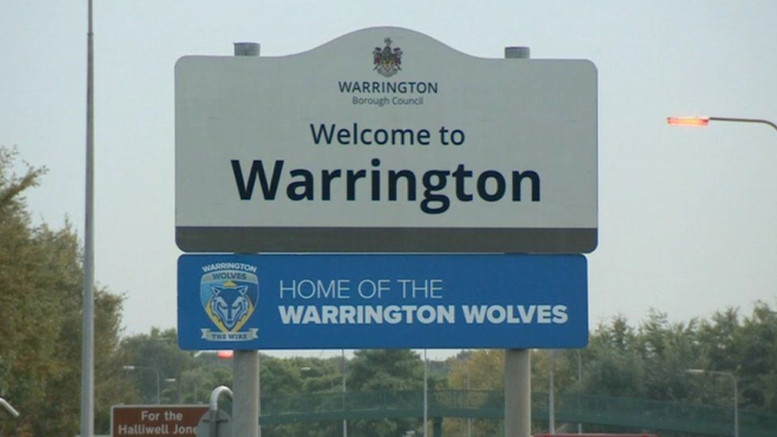
Housekeeping
No smoking stadium (including vaping)
No Fire Alarm test planned – fire exits signposted green
First Aid – if required please highlight with a member of our team
Toilets – located at either end of the 40/20 lounge
Wi-Fi connection - Wolves Corporate Password - W0lv35C0rP

Slide 3


Slide 4




Reflections on the year

Slide 5
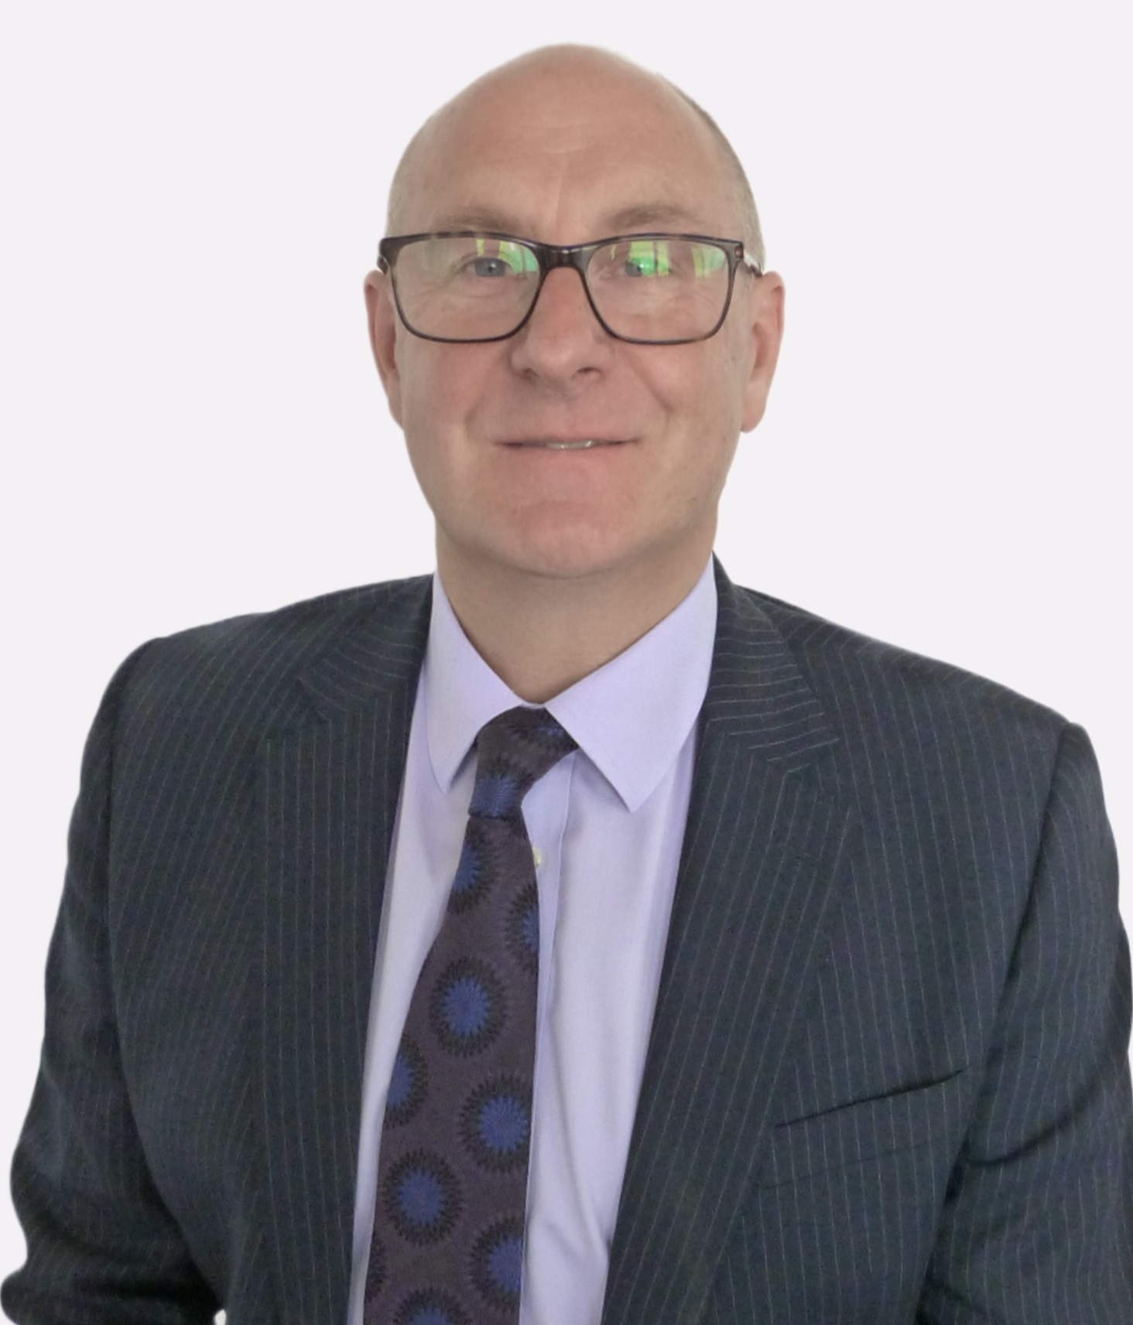
Annual Report - Performance 2022-23
Graham Urwin – Chief Executive

Slide 6














16 NHS providers
2 NHS provider collaboratives
570
pharmacies
313
dental services
286
eye services
Sefton
St Helens
Liverpool
Knowsley
Warrington
Wirral
344 GP practices
48 primary care networks
9 local authorities
12 hospice providers
1 ambulance service
Halton
Cheshire
West
9 Healthwatch
Voluntary, community, faith and social enterprise (VCFSE) sector
Other
partners
Cheshire
East
Supporting a population of 2.7 million people across 9 places

Slide 7
Extract from the NHS constitution
The NHS provides a comprehensive service, available to all.
Access to NHS services is based on clinical need, not an individual’s ability to pay.
“The NHS belongs to the people.
“It is there to improve our health and wellbeing, supporting us to keep mentally and physically well, to get better when we are ill and, when we cannot fully recover, to stay as well as we can to the end of our lives.
“It works at the limits of science – bringing the highest levels of human knowledge and skill to save lives and improve health.”

Slide 8
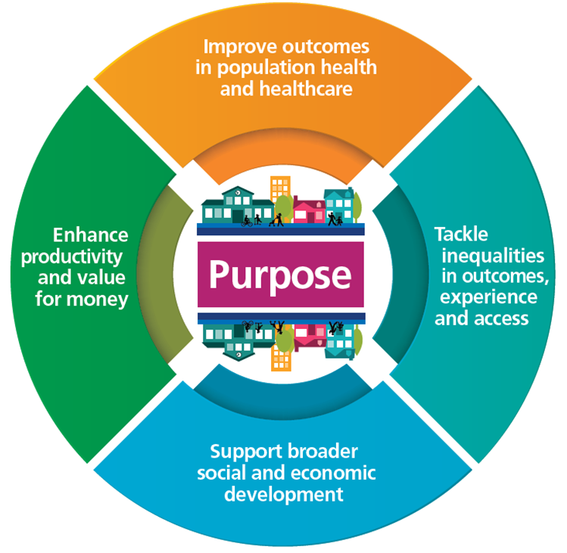

Slide 9

Primary Care
Total number of staff in general practice – 6,665 (WTE)
Now 1,150 additional WTE staff across Cheshire and Merseyside compared to 2019, including:
  Pharmacists
  Care co-ordinators
  Social prescribers

Slide 10
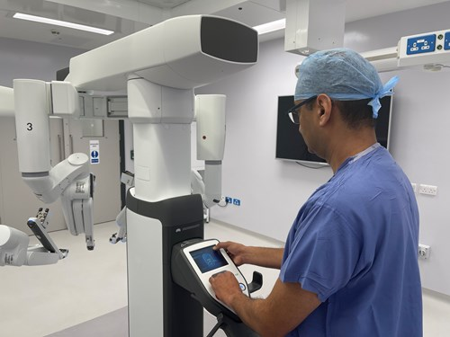
Elective recovery
First ICB in the North West to eliminate two-year waits and then 18-month waits following pandemic
Treated more than 100,000 patients from 65-week wait cohort since April 2023
More than 4,000 patients per week who would otherwise have waited 65 weeks will be seen by the end of March 2024
Facilitated mutual aid for more than 6,500 patients from eight different trusts to support the “levelling out” of waiting lists

Slide 11
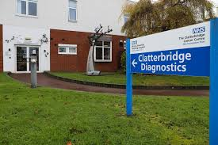
Diagnostics
Delivered 34,000 more diagnostic tests in 2022-23 than in 2018-19
Cheshire and Merseyside now delivers the third highest diagnostic activity of all 42 ICSs – doubling the number of CT scans, gastroscopies and audiology assessments in the last five years
Capacity to deliver 300,000 additional tests and scans by March 2024 thanks to eight community diagnostics centres – with two further CDCs in the pipeline

Slide 12


Cancer
People in Cheshire and Merseyside now more likely than ever before to have cancer detected in its earliest stages - second biggest improvement nationally in last five years (52.3% in 2018, 59.1% now)
Earlier diagnosis of lung cancer via targeted screening of current and ex-smokers
13,500 more patients referred on a two-week pathway in 2022-23 than in the previous year

Slide 13
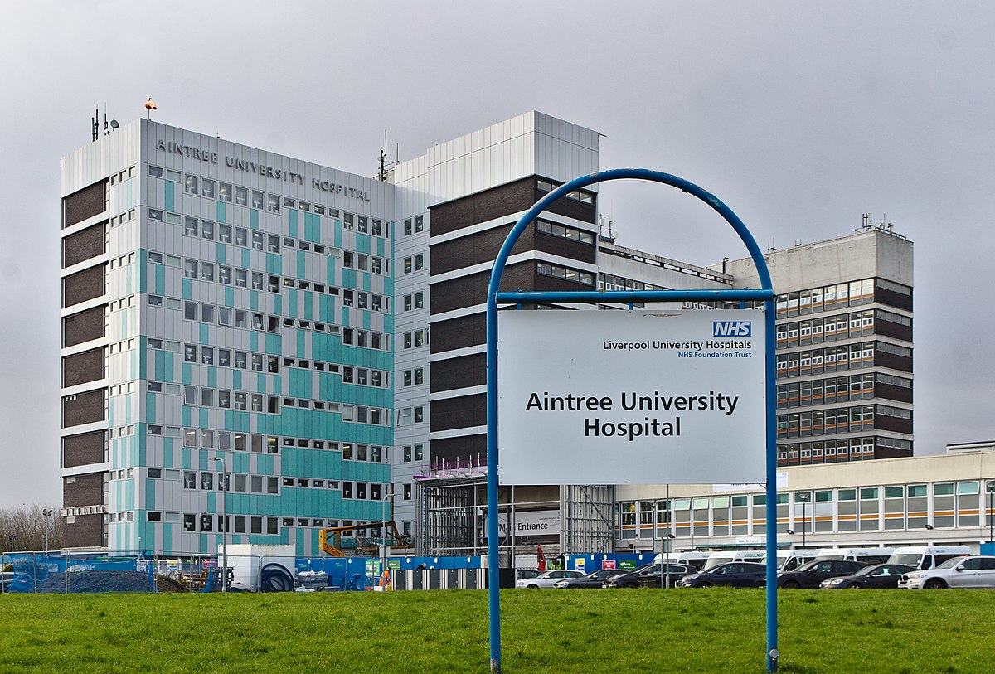
Tertiary care
Hyper-Acute Stroke Unit established at Aintree Hospital in September 2022 – providing specialist care in critical 72-hour period following stroke
Stroke Emergency Assessment Centre subsequently established – giving patients direct access to specialist stroke care, bypassing A&E

Slide 14

Mental Health
Exceeding national target on access to talking therapies - 91% seen within six weeks
More physical health checks for people with severe mental illness in 2022-23 than ever before
More than 90% of PCNs now have access to Primary Care Mental Health Practitioners
Every area in Cheshire and Merseyside now has 24/7 mental health crisis provision for both adults and children and young people

Slide 15

Community
Virtual Ward capacity to grow from 342 ‘beds’ to 560 by March 2024 (current utilisation 73%)
Remote monitoring heart failure virtual ward – winner of national HSJ Patient Safety Award
Two-hour Urgent Community Response providing rapid support for people in crisis who suffer sudden deterioration in their condition

Slide 16


Digital – turning intelligence into action
Increasing use of NHS App
Telehealth service supporting 2,000 patients to self-manage long-term conditions every day
Ground-breaking AI initiative to identify and support people on waiting lists who are at higher risk of post-op complications

Slide 17
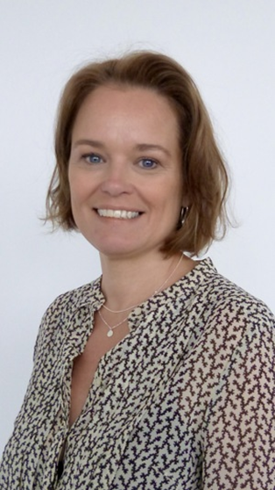
Annual Report and Accounts 2022-23
Claire Wilson - Director of Finance
www.cheshireandmerseyside.nhs.uk/latest/reports/annual-reports

Slide 18

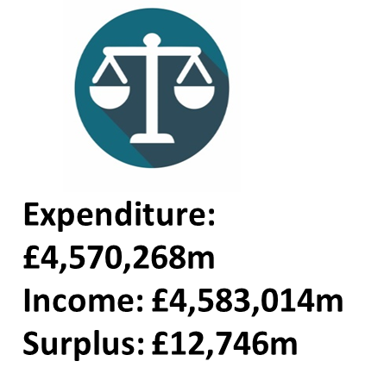



Population: c2.7m
Spend Per Head: £1,697
Financial Duties | Achieved
Breakeven duty - Act with a view to ensuring expenditure does not exceed the allocation received | Yes
Ensure capital expenditure does not exceed resource available | Yes
Comply with Mental Health Investment Standard | Yes
Ensure running costs do not exceed allocation | Yes
NHS partners collective duty to work towards achieving system financial balance | Partial
Efficiencies
Plan: £68.8m
Actual: £68.8m
Variance: £0m
Better Payment Practice Code
Target: 95.0%
Number: 98.54%
Value: 98.23%
External Audit:
Accounts – unqualified

Slide 19




What we spend our money on
Total spend £4,570m
Hospital-based care £2,409m
Mental health £434m
Community £481m
Continuing care £243m
Primary care £485m
Co-commissioning £414m
Other £63m
Running costs £41m

Slide 20
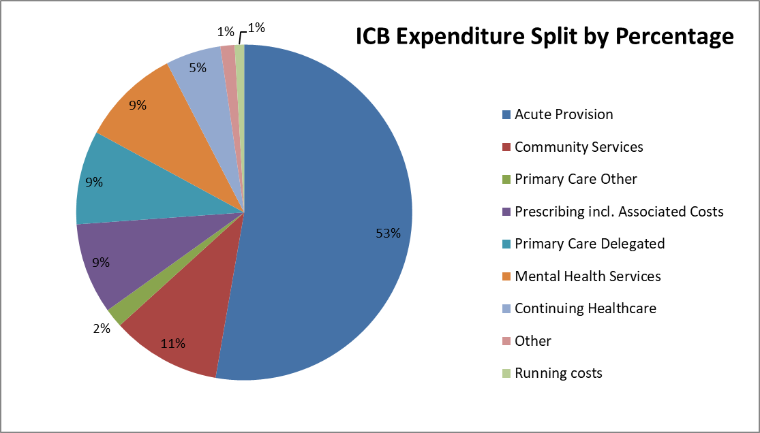

Slide 21
Looking ahead - capital investments 2023-24
£40m modernisation - Mossley Hill Hospital MH facility
Further investment in Warrington (£7.5m) and Clatterbridge (£4m) community diagnostic centres
£5m on new Arrowe Park Hospital A&E
Further elective recovery investment at both Mid Cheshire (£9.5m) and Alder Hey (£4m)
Electronic Patient Records – Liverpool (£19m), Mid and East Cheshire (£15m), Warrington (£7m)

Slide 22

Q&A

Slide 23

Keep in touch
Website: cheshireandmerseyside.nhs.uk
Social media - @NHSCandM
Email: enquiries@cheshireandmerseyside.nhs.uk
Citizens Panel: citizenspanel@cheshireandmerseyside.nhs.uk

