Slide 1
Management and Treatment of Dyspepsia in adults in General Practice
Education for healthcare professionals

Slide 2
Please refer to this section first:
Assessing Dyspepsia in adults in General Practice
(including Helicobacter Pylori)

Slide 3


Management and Treatment of Dyspepsia in adults - Introduction
The following guidance assumes the patient has no red flags and has received any required assessments and investigations where necessary i.e. clinical history, examination, baseline bloods, Helicobacter Pylori status(where indicated)
Dyspepsia - unidentified cause | Health topics A to Z | CKS | NICE

Slide 4
Key take home messages
The vast majority of patients with dyspepsia without red flags can have their dyspepsia investigated and managed in primary care without the need for endoscopy, the results of which rarely alter management.
Professionals and patients need to understand the importance of lifestyle and self-management of their symptoms and the positive impact this can have.
All medication taken for dyspepsia are to be taken for as short a period as possible i.e. AVOID long term prescriptions.
Note that PPI can mask red flag symptoms and should not be prescribed where red flags exist.
Be aware of rebound hypersecretion symptoms on stopping PPI which is well recognised and requires confident management to avoid slipping into long term use.

Slide 5

Medication review and management
  Consider reducing or stopping (if possible and appropriate) any drugs that may cause or exacerbate symptoms detected during your assessment:
    Alpha-blockers, anticholinergics, aspirin, benzodiazepines, beta-blockers, bisphosphonates, calcium-channel blockers, corticosteroids, nitrates, nonsteroidal anti-inflammatory drugs (NSAIDs), theophyllines, and tricyclic antidepressants.
  If dyspepsia symptoms are associated with NSAID use, encourage the person to stop the NSAID, if possible and appropriate
  Ask about the number and duration of any previous courses of antibiotics, which may affect the choice of Helicobacter pylori eradication regimen used (if needed)
  The combination of selective serotonin-reuptake inhibitors and NSAIDs/aspirin significantly increases a person’s risk of GI bleeding. You should consider gastroprotection for your patient in these situations

Slide 6

Don’t forget
Don’t forget ‘Over the Counter Medication’ and ‘borrowed’ medication & advise accordingly
Patients often forget to mention any medication they might be buying to self-medicate - either medication which might contribute to their dyspepsia or medication to relieve their symptoms
Patients also ‘borrow’ medication from friends and family
Advise that self-treatment with a PPI, antacid and/or alginate may be used for short-term symptom control, but long-term, continuous use is not recommended

Slide 7


Lifestyle and self help
Most symptoms of indigestion can be improved by several lifestyle and self-help measures and patients need to understand how important these factors are rather than relying on medication, with associated long-term effects or expecting hospital investigations, which rarely alter management.
Use written information and advice along with any online resources to support your patient.
Scenario: Dyspepsia - unidentified cause | Management | Dyspepsia - unidentified cause | CKS | NICE

Slide 8





Lifestyle and self-help
The following are key lifestyle and self-help measures which may limit the need for dyspepsia relieving medication:
Keeping a healthy weight - Being overweight increases intra-abdominal pressure, which relaxes the lower oesophageal sphincter and thus exposes the oesophageal mucosa to the gastric contents
Smoking cessation - smoking chronically reduces the lower oesophageal sphincter pressure, predisposing to acid reflux
Raising the head of the bed by 10-20cm - to allow gravity to keep the gastric juices away from the gastro-oesophageal junction
Avoiding wearing tight clothing or belts which exert pressure over the stomach
Addressing and managing stress symptoms through exercise and relaxation etc

Slide 9







Lifestyle and self help
Eating regular meals, not skipping meals, avoiding large meals, taking time to chew food properly and not rushing
Avoiding alcohol with supported reduction where required rather than stopping excessive drinking abruptly
Avoiding eating in the three hours before going to bed
Avoiding drinking any fluids two hours before bed
Avoiding spicy food
Avoiding drinks or food which are hot in temperature
Avoiding drinks containing caffeine (tea, coffee), chocolate, acidic drinks (eg orange juice, cola) and fatty foods

Slide 10

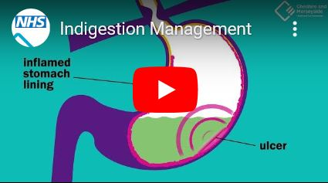

Supportive information for patients
Please encourage patients to watch the following animation:
‘The following animation film will help you understand why indigestion happens, when you need to be worried about your symptoms and all of the things you can do to help ease your symptoms’
Indigestion - NHS Cheshire and Merseyside

Slide 11
When to prescribe and when to check for Helicobacter Pylori
Offer one of the following strategies to manage uninvestigated dyspepsia symptoms, depending on clinical judgement (ie interventions around lifestyle, medication may be the first step in management prior to these steps):
  Prescribe a full-dose proton pump inhibitor (PPI) for 1 month
  OR
  Test for Helicobacter pylori infection if the person's status is not known or uncertain. If the person tests positive for H. pylori infection, prescribe first-line eradication therapy
If symptoms persist or recur following initial management:
Switch to the alternative strategy (for example, offer a full-dose PPI for 1 month if the person has been tested for H. pylori infection and vice versa)

Slide 12

Proton Pump Inhibitors PPIs
The main ‘issue’ with PPIs is the risk of slipping into long term use and the issues associated with this:
Increased risk of certain infections such as Clostridium Difficile (this can cause very severe diarrhoea) and pneumonia
Reducing the absorption of magnesium and vitamin B12
Reducing the absorption of calcium with increased risk of fractures
Therefore, it is advised that PPIs are used for the shortest period of time at the lowest effective dose
Proton pump inhibitors (PPIs) | Prescribing information | Dyspepsia - unidentified cause | CKS | NICE

Slide 13

Proton Pump Inhibitors PPIs
There are very few indications for the long-term use of PPIs:
Erosive oesophagitis and prevention of relapse
Treatment of PPI responsive eosinophilic oesophagitis
Prevention of peptic ulcer disease and its complication for patients at high risk
Chronic aspirin or NSAIDs use with concomitant use of steroids, antiplatelet medication, anticoagulants or if previous peptic ulcer
Barrett’s Oesophagus
Zollinger–Ellison syndrome

Slide 14

PPI Contraindications and cautions
Proton pump inhibitors (PPIs) should not be prescribed to people:
  With alarm symptoms before endoscopy, as PPIs may mask the symptoms of upper gastrointestinal malignancy
  If the person is already taking a PPI and subsequently needs an endoscopy, the PPI should be stopped at least 2 weeks before the procedure.
PPIs should be prescribed with caution to people:
  At risk of osteoporosis — the person should maintain an adequate intake of calcium and vitamin D, and if necessary, be given additional bone-sparing therapy
  At risk of hypomagnesaemia — if possible, magnesium levels should be checked before starting PPI therapy and intermittently during long-term treatment, for example if the person is prescribed drugs that can cause hypomagnesaemia, such as digoxin and diuretics
  MHRA, 2012; BNF 73, 2017

Slide 15
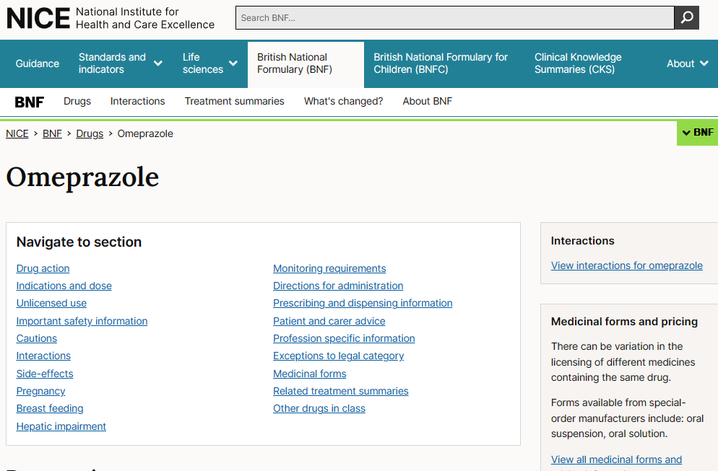

Medication dosing
Refer to the BNF for all matters relating to medication dosing
BNF (British National Formulary) | NICE

Slide 16
Adverse effects of PPIs
Adverse effects of proton pump inhibitors (PPIs) are usually mild and reversible
Adverse effects include headache, diarrhoea, nausea, vomiting, abdominal pain, constipation, and dizziness.
Less common adverse effects include dry mouth, peripheral oedema, sleep disturbance, fatigue, paraesthesia, arthralgia, myalgia, pruritus, and rash.
Rare or very rare adverse effects include:
  Subacute cutaneous lupus erythematosus (SCLE), which can occur weeks, months, or years after exposure to a PPI. If suspected discontinue the PPI and seek specialist advice if needed MHRA, 2015
  Severe cutaneous adverse reactions (SCARs) including Stevens-Johnson syndrome (SJS), toxic epidermal necrolysis (TEN), drug reaction with eosinophilia and systemic symptoms (DRESS) and acute generalized have been reported very rarely and rarely with omeprazole treatment.
  Taste disturbance, hepatitis, jaundice, depression, confusion, hallucinations, hyponatraemia, leucopenia, leucocytosis, pancytopenia, thrombocytopenia, visual disturbances, sweating, photophobia, and alopecia.
Long-term PPI treatment may be associated with uncommon, serious adverse effects such as:
  Hypomagnesaemia — symptoms include muscle twitching, tremors, vomiting, fatigue, and loss of appetite. Case reports after one year of PPI therapy, but may occur after 3 months. This usually improves after magnesium replacement therapy and discontinuation of the PPI MHRA, 2012. Hypomagnesaemia may lead to hypocalcaemia and/or hypokalaemia
  Increased risk of fractures — especially when used at high doses for over a year in the elderly MHRA, 2012
  Clostridium difficile infection — due to the effect of decreasing gastric acidity

Slide 17
Drug interactions with PPIs
Possible drug interactions with proton pump inhibitors (PPIs) include:
Digoxin — PPIs may cause a small rise in serum digoxin levels (although not considered clinically significant). The manufacturer of lansoprazole suggests that digoxin levels should be monitored if lansoprazole is started or stopped.
Warfarin — PPIs can occasionally enhance the effects of warfarin. The international normalized ratio (INR) should be monitored in people taking warfarin if omeprazole, pantoprazole, or esomeprazole is started or stopped.
Methotrexate — PPIs possibly reduce excretion of methotrexate, leading to an increased risk of methotrexate toxicity.
Phenytoin — omeprazole and esomeprazole can occasionally enhance the effects of phenytoin. The manufacturers recommend that people taking phenytoin are carefully monitored if omeprazole or esomeprazole is started or stopped.
Azole antifungals — the absorption of ketoconazole or itraconazole may be reduced during PPI treatment. Dose adjustment of the antifungal drug may be required during long-term PPI treatment.
Clopidogrel — omeprazole and esomeprazole reduce the antiplatelet effect of clopidogrel, and concomitant use should be avoided. The other PPIs may also reduce the efficacy of clopidogrel, and this risk should be weighed against the potential benefit of the PPI [MHRA, 2010]
Protease inhibitors — PPIs can significantly affect plasma levels of some protease inhibitor drugs, including:
  Atazanavir — concurrent use of PPIs and atazanavir is not recommended as the absorption of atazanavir may be affected by a PPI (due to changes in gastric acidity). This may lead to a reduced plasma concentration of atazanavir which may affect its efficacy. If concurrent use is necessary, seek specialist advice.
  Saquinavir — plasma concentration of saquinavir may be increased by PPI treatment, leading to increased risk of adverse effects.
  Tipranavir — concurrent use with omeprazole or esomeprazole is not recommended, as tipranavir may reduce the plasma concentration of the PPI. If concurrent use is necessary, seek specialist advice.

Slide 18

Stepping down ,Stopping PPI & rebound symptoms
PPI should be prescribed for as short a period as possible
PPI dosing might change for a number of reasons:
Reducing the dose
Taking prn
Stopping altogether
Dyspepsia symptoms may return; sometimes worse than before on stopping a PPI
These “rebound” hypersecretion symptoms are very common, well recognised and usually go within 2 to 4 weeks of stopping the PPI
During this time consider prescribing or recommending an alginate or antacid to ease these rebound symptoms rather than resuming a PPI – the latter increases the risk of slipping into long term prescribing with resulting potential harm

Slide 19

Refractory & recurrent symptoms…
Assess for any new alarm symptoms which may suggest a complication or other serious underlying pathology, and manage appropriately.
For people with persistent or recurrent dyspepsia symptoms despite initial management
  Consider whether your initial diagnosis is correct and explore other differentials eg cardiac
  Check the person's adherence to initial management and reinforce lifestyle advice
  Consider alternative acid suppression therapy with a histamine (H₂)-receptor antagonist (H₂RA)
  Consider the need for long-term acid suppression therapy if symptoms have previously responded
If the person is taking a nonsteroidal anti-inflammatory drug (NSAID) or aspirin and is unable to stop the drug, advise on:
  Reducing the NSAID dose, if possible, and offering long-term gastroprotection with acid suppression therapy
  Switching to an alternative to a NSAID, such as paracetamol or a cyclo-oxygenase (COX)-2 inhibitor, if appropriate
  Switching to an alternative antiplatelet drug, if appropriate

Slide 20
Refractory & recurrent symptoms…
Part 2
If the person has received first-line Helicobacter pylori eradication therapy, do not routinely offer H. pylori re-testing
  Consider offering re-testing for H. pylori, using clinical judgement, if:
    There has been poor compliance to first-line eradication therapy, or the initial test was performed within 2 weeks of proton pump inhibitor (PPI) or 4 weeks of antibiotic therapy.
    Aspirin or a NSAID is indicated, especially if there is a history of peptic ulcer disease
    There is a family history of gastric malignancy
    There are severe, persistent, or recurrent symptoms
    The person requests re-testing (for example if there is anxiety about whether H. pylori has been eradicated)
If H. pylori re-testing is indicated, arrange this at least four weeks (ideally 8 weeks) after initial eradication therapy (if this was needed).
  Offer the carbon-13 urea breath test first-line, or the stool antigen test second-line if the carbon-13 urea breath test is not available — ensure the person has not taken a PPI in the past 2 weeks, or antibiotics in the past 4 weeks
  If H. pylori re-testing is positive, prescribe second-line H. pylori eradication therapy as per Pan Mersey and Cheshire prescribing guidelines

Slide 21
Refractory & recurrent symptoms…
Part 3
Offer people on long-term treatment an annual review of their symptoms and treatment, and encourage the person to:
  Step down or stop treatment, if possible and appropriate (if there is no co-morbidity or co-medication that requires long-term acid suppression therapy):
    Use a PPI or H₂RA at the lowest effective dose to control symptoms
    Use a PPI or H₂RA as needed, if possible and appropriate
    Consider self-treatment with antacid and/or alginate therapy, although this is not recommended for long-term or continuous use
Ref to gastroenterology, including Advice & Guidance depending on clinical judgement, if:
  There are refractory or recurrent symptoms despite optimal management in primary care.
    If endoscopy is planned, ensure the person stops any acid suppression therapy for at least two weeks before the procedure date, and suggest self-treatment with antacid and/or alginate therapy if needed
    Note: H. pylori re-testing may be performed during endoscopic examination in secondary care
  Treatment with a second-line H. pylori eradication regimen has been unsuccessful
  There are limited antibiotic options for H. pylori eradication therapy, due to hypersensitivity, known local high antibiotic resistance rates, or previous use of clarithromycin, metronidazole, and a quinolone

Slide 22


Dyspepsia in pregnancy
Advise the woman to:
  Eat smaller meals more frequently (every 3 hours), not eat late at night (or less than 3 hours before bedtime), eat healthily, and avoid known irritants (for example alcohol, caffeine, fruit juices and carbonated drinks, chocolate, and fatty and spicy foods).
  Keep a food diary to identify triggers
  Try to avoid excessive weight gain and to maintain regular physical activity.
  Try raising the head of their bed by 10–15 cm
  Try to sleep on the left side rather than on the right side or supine
  Avoid medications that may cause or worsen symptoms, if appropriate (for example calcium-channel antagonists, anticholinergics, antidepressants, and nonsteroidal anti-inflammatory drugs)
  Stop smoking (if applicable)
Dyspepsia - pregnancy-associated | Health topics A to Z | CKS | NICE

Slide 23

Dyspepsia in pregnancy part 2
Antacids and alginates are recommended as first-line treatments if symptoms are not controlled adequately by lifestyle changes.
Antacid preparations such as those containing combinations of aluminium and magnesium (co-magaldrox) or alginate products (for example Gaviscon® Advance) are recommended on an 'as required' basis.
Calcium-containing products may be used on a short-term or occasional use basis.
Products containing sodium bicarbonate or magnesium trisilicate are not recommended in pregnancy.
Liquid products are usually faster acting and more effective than tablets.
Advise women to avoid taking antacids within two hours of iron or folate supplements as antacids can affect absorption of other medication

Slide 24
Dyspepsia in pregnancy part 3
If symptoms are very severe, and persist despite lifestyle changes and treatment with an antacid or alginate, consider prescribing an acid-suppressing drug
  CKS recommends using acid-suppressing drugs only as a last resort in severe cases in primary care, and only after a shared-care discussion about the potential risks and benefits, and about the limited evidence available regarding efficacy and safety in pregnancy. These options may be more appropriate for use in secondary care for the more serious cases or those with complications.
  Signpost women to sources of further information such as leaflets provided by the UK Teratology Information Service (UKTIS):
    UKTIS, BUMPS: H2 receptor antagonists use in pregnancy
    UKTIS, BUMPS: Omeprazole use in pregnancy
  Since ranitidine has been withdrawn, the preferred H2 receptor antagonist option would be famotidine, but the manufacturer does not recommend use in pregnancy, and advises it should only be prescribed if clearly needed.
  Of the proton pump inhibitors (PPIs) available, the manufacturer of omeprazole advises that it can be used in pregnancy but there is a lack of good quality evidence regarding safety, some possible concerns about a small increased risk of congenital malformations, and a possible association with childhood asthma and allergy. There is a lack of data for other PPIs, although the manufacturer of pantoprazole states that what data there is indicates no evidence of harm to the baby.

Slide 25
Dyspepsia in pregnancy part 4
When should I refer or seek specialist advice?
Refer immediately (same-day) if there is dyspepsia and significant acute gastrointestinal bleeding.
Refer urgently to a gastroenterologist there are features suggestive of malignancy. For more information, see the CKS topic on Gastrointestinal tract (upper) cancers - recognition and referral.
  Note that the classical alarm features of weight loss, an epigastric mass, persistent abdominal pain or iron deficiency anaemia may be difficult to interpret in pregnancy.
Refer non-urgently to a gastroenterologist if:
  Symptoms do not adequately respond to antacids, alginates, or other treatments given in primary care. (Refer more urgently if the symptoms are so severe that they affect the woman's ability to eat sufficiently.)
  There is doubt about the diagnosis.
Refer to an obstetrician if symptoms suggest a pregnancy-related disorder other than dyspepsia, for example pre-eclampsia or HELLP syndrome (haemolysis, elevated liver enzymes, and low platelets) — use clinical judgement regarding urgency of referral depending on the presenting problem.

Slide 26
Prokinetics – don’t prescribe them
Domperidone and metoclopramide were often used for conditions such as persistent GORD or oesophageal dysmotility
In 2013 the MHRA issued a warning about the long-term use of metoclopramide relating to a risk of neurological adverse effects
The MHRA advised that metoclopramide should be used in the short term only (up to five days) for nausea and vomiting due to its potential for neurological side effects (short-term extrapyramidal disorders, involuntary movement disorders, and tardive dyskinesias)
In 2014 a further warning came about the increased risk of serious cardiac side effects with the use of regular domperidone
Although prokinetics were useful and effective for certain cases of GORD and oesophageal dysmotility in the past, there is no longer any role for them for the treatment of persistent GORD due to their potential for problematic side effects. Their use in dysmotility might sometimes be seen in secondary care but is becoming rare, again due to the side effect profile.

Slide 27

Preventing further episodes of indigestion
Emphasising the importance of Self-help and lifestyle are key to preventing and reducing the risk of future bouts of indigestion
Consider the longer-term implications of ongoing medication, especially PPI

Slide 28



Take Home Messages:
‘Management and Treatment of Dyspepsia of adults in General Practice’
Always look out for red flag symptoms of dyspepsia, especially if symptoms increase or persist or change adversely noting that PPI can mask symptoms
Indigestion can frequently be managed through self-help and lifestyle changes but is often overlooked with medication offered early which frequently becomes a long term/repeat prescription with the risk of side effects
Most patients do not require an endoscopy unless they have received optimal management (including lifestyle modification) or have red flags

