Slide 1
Diverticular disease
Education for healthcare professionals

Slide 2
Contents
Definition
Causes/risk factors
Assessment
Investigation
Referral
Management/complications

Slide 3
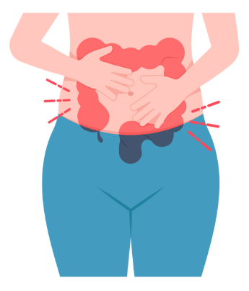
Definitions
Divertulosis = presence of diverticular (pouching) with in intestine
Diverticular disease = symptoms arising from the presence of diverticular, such as mild abdominal pain or tenderness without systemic illness
Acute diverticulitis = acute infection or inflammation of diverticular, can be complicated by sepsis, abscess formation, fistula, stricture or perforation.
Divertulosis is defined by NICE guidance as asymptomatic – for many people it will remain undiagnosed therefore it is hard to determine prevalence of diverticula, but likely to become more common with age.

Slide 4
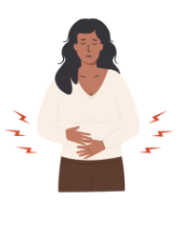
Diagnosis of Diverticular Disease
Symptoms of:
Intermittent left lower abdominal pain – may be triggered by eating, and relieved by passage of flatus
Tenderness in left lower abdomen on examination
  Be aware that in some patient groups – pain and tenderness may localise to the right side, especially in people of Asian origin
These symptoms may overlap with many other conditions such as IBS, colitis or malignancy
NICE Guidance NG147 on Diverticular disease found no evidence on diagnosing Diverticular disease so recommendations have been made on expert knowledge of current best practice.

Slide 5
Diagnosis of Diverticular disease continued
Routine Imaging or Endoscopy to confirm the presence of diverticula and exclude other causes
  these may be arranged by primary care directly where available as suspected diverticular disease alone is not an indicatory for referral- unless these tests are not available, Or colitis is suspected, Or the person meets the criteria for a suspected cancer pathway they may be arranged in secondary care.
If the person meets the criteria for an urgent suspected cancer pathway refer/investigate by this route
  In Cheshire and Merseyside (in line with national recommendations) assessment of symptoms in adults which could represent Lower GI cancers should be assessed by history and examination including rectal examination and then either direct urgent suspected cancer referral, referral along with FIT and bloods or FIT and bloods and await results to consider referral urgency. See link

Slide 6
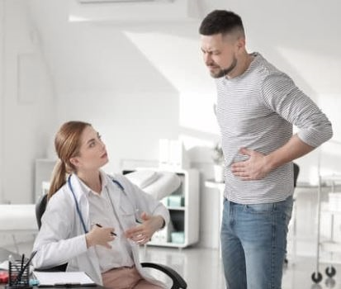
Management and advice for diverticular disease
Antibiotics are not indicated in diverticular disease – only in acute diverticulosis (discussed later in this presentation) with signs of systemic illness, or immunocompromise
Advise people to avoid NSAIDs and opioid analgesia if possible, to reduce the risk of perforation
Advice on diet, fluid intake, stopping smoking, weight loss and exercise.
Specifically advise on benefits of increasing dietary fibre (may take several weeks to achieve), then if tolerated maintaining high-fibre diet for life

Slide 7
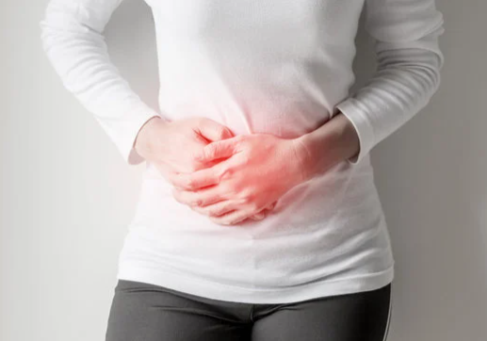
Management and advice for diverticular disease
If high-fibre diet is not tolerated, or the person has persistent constipation or diarrhoea then consider bulk forming laxatives.
If ongoing abdominal pain requiring analgesia use paracetamol
If there is abdominal cramping consider use of antispasmodic
If there are persistent symptoms, or symptoms do not respond to treatment consider alternative causes and investigate as appropriate

Slide 8
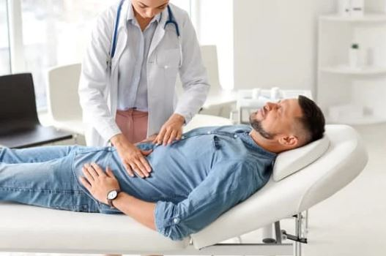
Diagnosis of Acute diverticulitis
Suspect acute diverticulitis if there is constant abdominal pain, usually localising to the Left lower Quadrant (but with awareness that in a minority of people, and people of Asian origin Right sided pain and tenderness localisation may occur) with any of the following:
  Fever,
  Sudden change in bowel habit and significant rectal bleeding or rectal mucus,
  In those with a history of diverticulosis or diverticulitis - Tenderness in lower abdo (left side most commonly but could be right sided), palpable abdominal mass
Following thorough history and examination which may include digital rectal examination or pelvic examination in women to evaluate possible gynaecological causes of the pain.
    Nonsteroidal anti-inflammatory drugs (NSAIDs)

Slide 9
Signs of complications
Assess for these and refer for same day hospital assessment if the person has any of the below symptoms or signs along with uncontrolled abdominal pain
Symptom or Sign | Possible complication
Abdominal mass, or peri-rectal fullness on rectal examination | Intra-abdominal abscess
Abdominal Guarding or rigidity | Bowel perforation and peritonitis
Sepsis signs such as altered mental state, raised heart rate or respiratory rate, low Blood pressure or temp, no urine out put or skin discolouration | Sepsis
Passage of faeces vaginally, faecaluria, pneumaturia, pyuria | Fistula to bladder or vagina
Absolute constipation, vomiting, abdominal distention, colicky abdominal pain, | Intestinal obstruction

Slide 10

Acute diverticulitis- Assessment continued
Other features where same-day hospital assessment recommended:
  Dehydration or at risk of dehydration/unable to take or tolerate oral fluids at home
  Unable to tolerate oral antibiotics if needed at home
  Aged over 65
  Significant co-morbidity or immunosuppression

Slide 11

Investigation of suspected acute diverticulitis
Investigation of suspected acute diverticulitis for people with suspected uncomplicated acute diverticulitis who are not referred for same day hospital assessment:
Reassess if symptoms worse or persist and consider referral to secondary care for further assessment
NICE guidance states insufficient evidence on diagnostic tests for people who are not referred for same day hospital assessment so highlight the importance or reassessment, and re-consideration of referral is symptoms worsening or persisting.
For people who are referred to secondary care for same day assessment FBC, CRP are recommended to identify inflammation, and renal function to determine if contrast CT can be performed

Slide 12





Summary of patient advice for diverticular and diverticulitis
Eat and healthy balance diet including whole grains, fruits and vegetables.
Slowly increase fibre intake and drink plenty of water with this.
Stop smoking
Maintain a healthy weight
Do not take NSAIDS
Do not take opioids

Slide 13
References/links
Scenario: Acute diverticulitis | Management | Diverticular disease | CKS | NICE
Overview | Diverticular disease: diagnosis and management | Guidance | NICE
Recommendations | Diverticular disease: diagnosis and management | Guidance | NICE

