Slide 1
Dysphagia
Difficulty with the act of swallowing
Education for healthcare professionals

Slide 2
Contents:
Definition
Causes
Assessment including EDS
Referral/Investigation guidance – NG12
Diagnostics and management

Slide 3
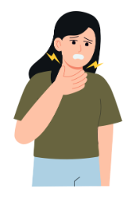
Dysphagia = Difficulty with the act of swallowing
Can be objective or subjective, structural or functional – thorough history and examination essential
NICE Urgent suspected cancer referral guidelines recommend urgent referral for direct access upper GI endoscopy for dysphagia symptoms
Edinburgh Dysphagia Score can be helpful to identify those at higher risk of malignancy as a cause for dysphagia
Many non-malignant GI causes of dysphagia symptoms can be improved with conservative measures such as medication and lifestyle changes.

Slide 4
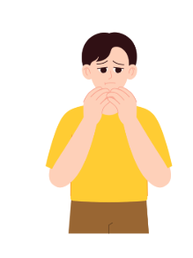
Description
Dysphagia = difficulty with the act of swallowing solids or Liquids
It may be subjective or objective
Can refer to food ‘sticking’ or not passing, a sensation of not being able to swallow, choking episodes or a globus sensation.
Globus = sensation of a lump in throat
Can be caused by functional or structural abnormalities or the oral cavity, pharynx, oesophagus or gastric areas
Commonly occurring – one in 17 people in their lifetime.

Slide 5
Causes
 | Structural | Neurological | Other
Oral | Dentition/dentures Xerostomia Craniofacial
Pharyngeal | Pharyngeal pouch Cervical osteophytes Pharyngeal web Acute infection- Quinsy, epiglottitis, abscess etc Thermal Burn Iatrogenic – post radiation, tracheostomy etc | CVA Parkinsons disease Parkinsonisms Dementia MS MND Peripheral neuropathies Tardive dyskinesia Cervical discectomies | Inflammatory myopathy Cricopharyngeal dysfunction Respiratory conditions - COPD
Oesophageal | GORD Oesophagitis Peptic strictures Thyroid compression | Oesophageal dysmotility Achalasia | Eosinophilic oesophagitis Systemic sclerosis Lymphocytic oesophagitis Sjogrens disease

Slide 6
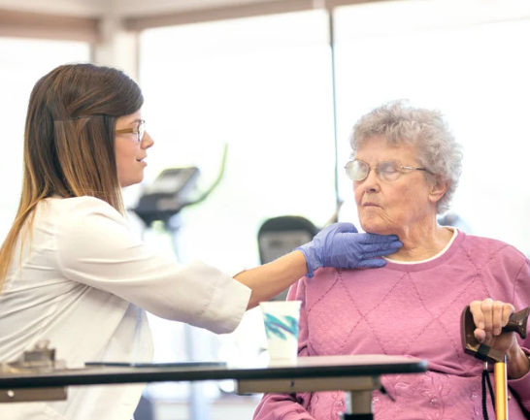
Assessment
Duration – important to establish if acute or chronic – short history more indicative of malignancy
Consider the different phases of swallow:
Oral phase – can they chew adequately?
Pharyngeal phase – are there signs that the airway is not being adequately protected leading to aspiration?
Oesophageal phase – are there issues of slow passage of food, obstruction or regurgitation?
Asking where the difficulty in swallowing is felt can sometimes localise the site of issue – suprasternal may be more likely to be pharyngeal vs retrosternal for oesophageal. But lacks specificity
Edinburgh Dysphagia Score
Risk factors – smoking and alcohol are independent risk factors for head and neck and oesophageal cancer.
Examination, including weight, abdo exam etc.
Sequalae – weight, nutrition etc

Slide 7
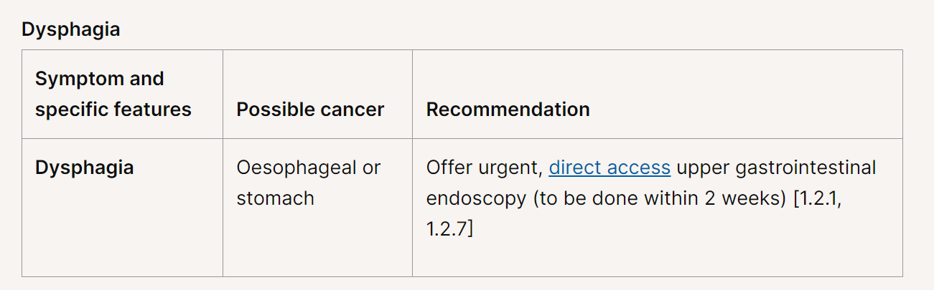
Red flag symptoms for oesophageal cancer
Red flag symptoms for oesophageal cancer that should prompt urgent referral (<2 weeks) for upper gastrointestinal endoscopy
  Dysphagia or
  Aged 55 and over with unintentional weight loss and any of the following:
  Upper abdominal pain
  Reflux
  Dyspepsia
* Be aware that dysphagia localised to above the clavicles, associated with hoarseness or neck could indicate a Head & Neck cancer and referral on an Urgent Suspected Head and Neck cancer pathway should be considered.

Slide 8
Edinburgh Dysphagia Score
A national prospective cohort study has confirmed that EDS has high sensitivity and negative predictive value for UGI cancer, and recommended a modified version be used for triage of urgent suspected cancer referrals. Useful to include information in referral for interpretation in secondary care, not to use as a referral decision tool in primary care
A + B + C + D + E + F = score. If >3.5 high risk malignancy.
A Age | Points
18-39 | 0
40-49 | 4
50-59 | 5
60-69 | 6
70-79 | 7
80-89 | 8
90-99 | 9
B Gender | Points
Male | 0
Female | -1
C Current acid reflux | Points
Yes | -1
No | 0
D Dysphagia localises to the neck | Points
Yes | -1
No | 0
E Weight Loss >3kg | Points
Yes | 2
No | 0
F Duration of symptoms | Points
Yes | -1.5
No | 0
    Nonsteroidal anti-inflammatory drugs (NSAIDs)

Slide 9



Diagnosis and outcomes
Endoscopy
Treatment of underlying cause if diagnosed.
Consider Speech and Language Therapy
Consider dietician input

Slide 10
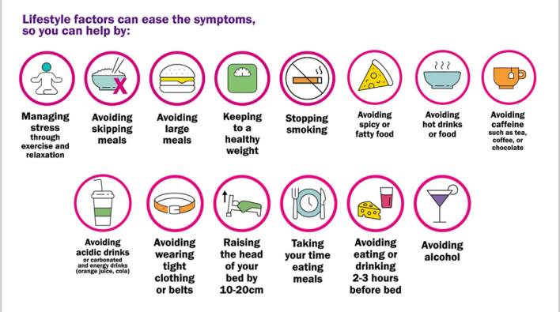
If dysphagia is reflux related Lifestyle measures can help with symptoms:

Slide 11
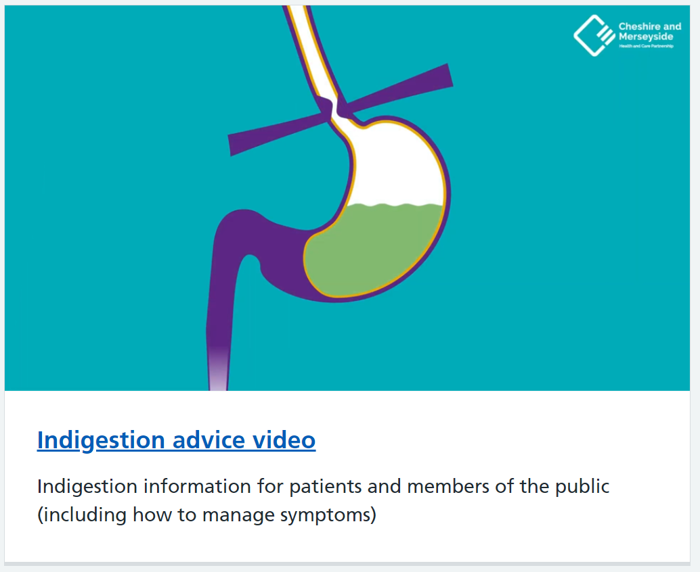
Endoscopy case studies - NHS Cheshire and Merseyside

Slide 12
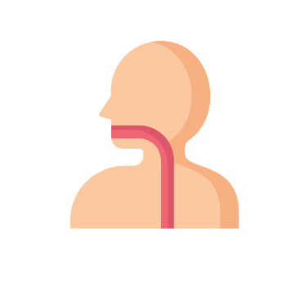
Key messages
Many causes of dysphagia and a common symptom in primary care – history and examination can indicate most appropriate route of investigation
Edinburgh dysphagia score along with history and examination can help identify those at highest risk of malignancy
Many non-malignant GI causes of dysphagia symptoms can be improved with conservative measures such as medication and lifestyle changes.

