Slide 1
CMAST 24/25 Plan
Q2 Update
Diagnostics Programme

Slide 2
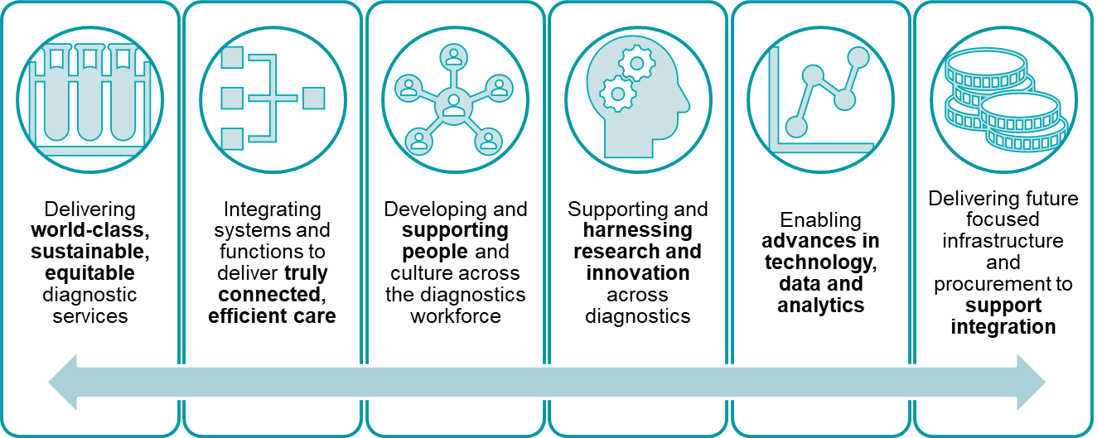
Strategic Direction
Cheshire and Merseyside 5-year strategy (2023-28) to deliver against six key priorities:
To deliver we will:
Reduce waiting times
Reduce inappropriate demand
Digitise and innovate
Increase capacity/
access
Maximise productivity
Secure
income
Reduce
cost
Workforce Resilience
Standardise
pathways
1
2
3
4
5
6
7
8
9

Slide 3


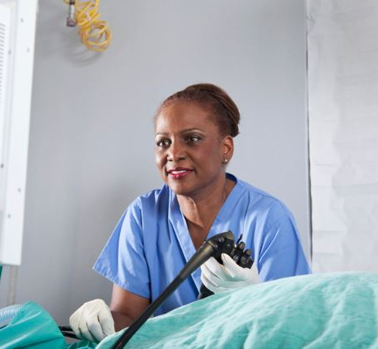
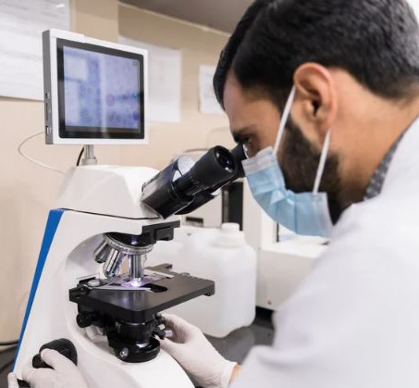
Income Secured
£28.73m Capital 24/25 Schemes include:
Cardiac CT in Liverpool
Complete CDCs in Halton and East Cheshire
Pathology LIMs system for C&M
NEW - £360k awarded for Mid Cheshire Trans Nasal Gastroscopy
NEW - £469k awarded for Chest X-Ray AI
£59.45m Revenue (excludes programme funding) 24/25 Schemes include:
450,000 tests in 10 CDCs (funding beyond ERF)
NEW - £1.25m for Digital Pathology

Slide 4
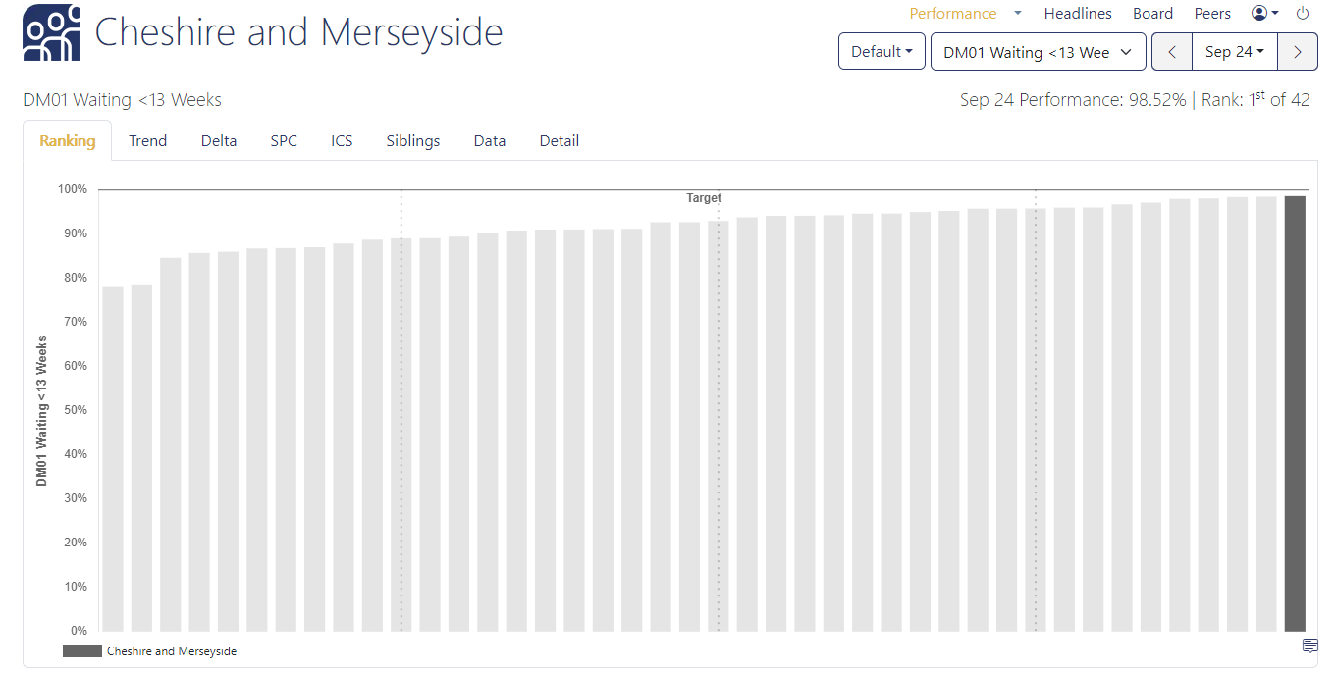
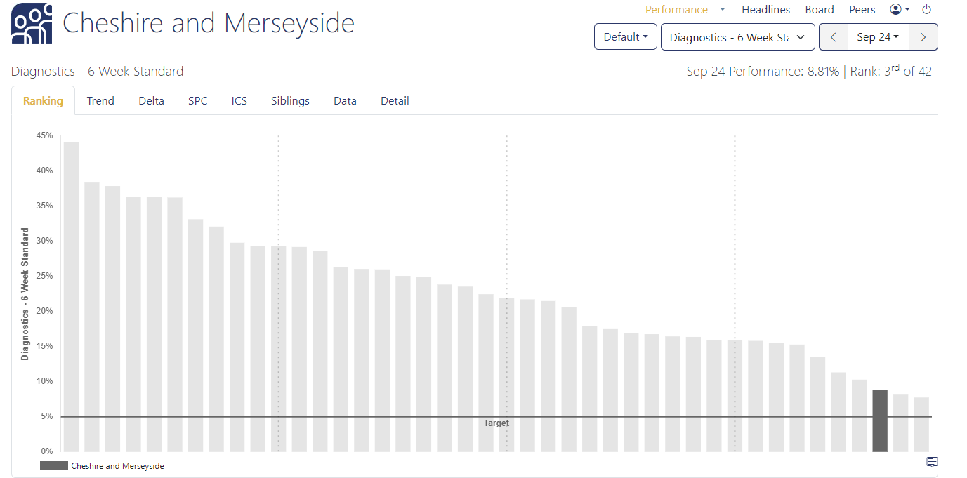
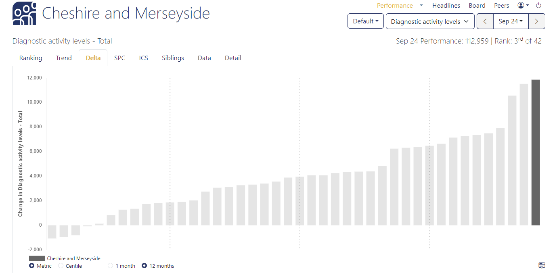
Performance
Seen within 13 weeks
98.5%
Ranking 1st out of 42 ICSs
Waiting 6 weeks+
8.81%
Ranking 3rd out of 42 ICSs
Activity Change in 12 months
11,855 more tests per month
Ranking 1st out of 42 ICSs

Slide 5
Endoscopy
We have….. | Resulting in…. | And financially…..
Reviewed surveillance intervals | 1038 patients appropriately discharged. | Saved c£600k
Introduced BOTS to carry out admin tasks. | 3 BOTS deployed. 730 hours saved per month. | Saved c160k Saved recurrently 2 x band 2 staff
Overseen build of 2 new Endoscopy theatres in Halton. | 468 additional patients receiving endoscopy in Halton. 51 additional patients have attended for bowel cancer screening. | Secured £4.998m to deliver this.
Established an Advanced Endoscopy Network Service | Standardised evidence based C&M pathways agreed for EUS, ERCP, complex polypectomy. Reducing need for surgery, | Secured £900k to deliver this.

Slide 6
Imaging
We have… | Resulting in … | And financially …
A new single collaborative contract in place for radiology reporting. | Increased quality, reduced duplication and reduced reporting waits and enable us to meet Royal College of Radiology (RCR) Guidelines: CT - 95% urgent with 7 days CT – 95% routine within 28 days MRI – 90% of urgent within 7 days MRI – 95% routine within 28 days | On track to achieve annual savings of c£56k Recommendation to change provider and deliver a further £400k of cost avoidance presented to COOs
Implemented MRI Advanced Acceleration Technology | 10% productivity gains. | Recurrently save c£167k
Implemented Prostate Artificial Intelligence reporting images technical solution (at testing stage now before final go-live) | Savings to consultant reporting time enabling other images to be reported on quicker | Will recurrently save c£30k per annum
Reduced DNAs and hospital cancellations in Imaging | So far reduced: CT to 1.1% (target 2.5%) MRI to 2.4% (target 3%) DEXA to 2.2% (target 2.5%) | Savings being calculated for end March 25

Slide 7
Community Diagnostic Centres (CDCs)
& Physiological Science
We have … | Resulting in … | And financially…
10 CDC sites open and delivering agreed planned activity. | Activity of 196,118 tests against plan of 180,887 so far. | Total new revenue for system in year £47m Total capital in year £4.3m Estimated year-end additional capital £0.75m Pathway revenue £0.5m
Launched one of England’s first Physiological Sciences Network | Engagement from all modalities and across Trusts and Communities of Practice leads identified. | Watch this space for 2025/26 plans.

Slide 8
Pathology
We have … | Will result in … | And financially…
Signed contract for LIMS | Increased: Access to pathology reports. System capability, resilience and protection against cyber threats. Reduced: Staff time per test Lab to lab referrals Cost of duplicate test Impact on patients of repeat tests Cost to support legacy LIMS systems | £10m (cash releasing) benefits across 10 years.
Progressed plans for the Pathology 3 Hub Model to be implemented in 2026. | Consolidated more efficient, resilient pathology service. | Up to £16m (cash and non-cash releasing) per annum.

Slide 9

What Next?
Implement LIMS
Improve turnaround times in Pathology
Same day inpatient tests
Ensure LOS not prolonged due to diagnostics
Same day urgent care tests
Implement 3 Hub Pathology Model
Deliver 95% Waiting Time Target
Ensure Cancer FDS is met
Prevent urgent attendances / admissions
Maximise productivity
Ensure resilience of service
Meet Ops Plan target and lead the way in NW and England.
Notes:
Issue re ECHO capacity still exists across the system. Although MRI capacity is no longer an issue with the exception of Stress MRI tests.

Slide 10
What Next?
Secure Funding for 25/26
CDC – likely to be further capital and revenue funding
Efficiency and Productivity
Increase Digital Pathology Reporting
Reducing turnaround times in pathology
Key messages are to detail productivity and efficiency benefits of previous investment – DM01 remaining main measure
Have been asked for ideas for CDC expansion / additional
Likely to be funding for “scanners” – awaiting detail
Likely to be funding for digital schemes (possibly focussed on endoscopy and physiological sciences)

Slide 11
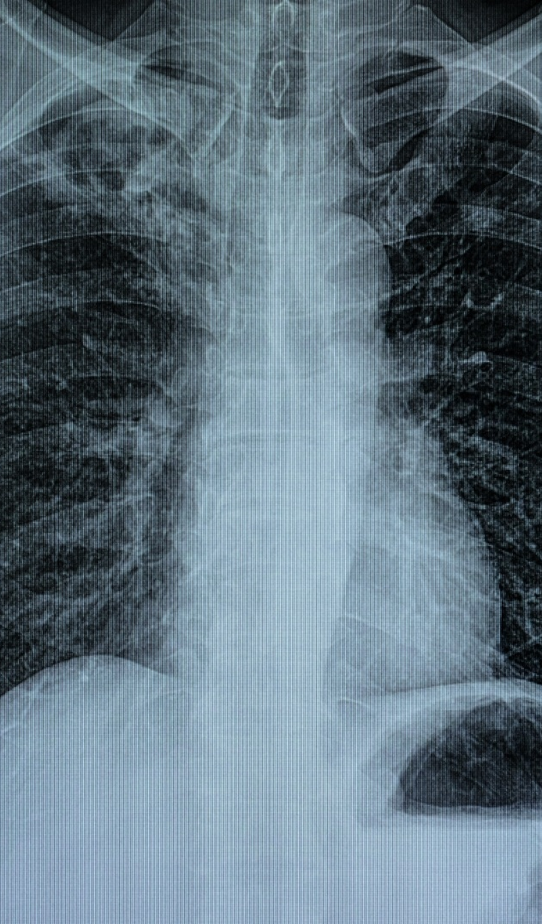

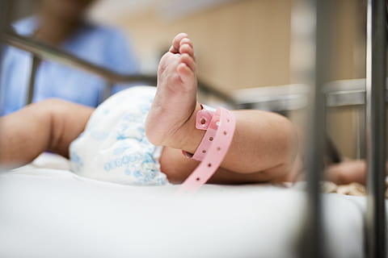
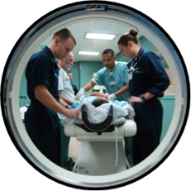
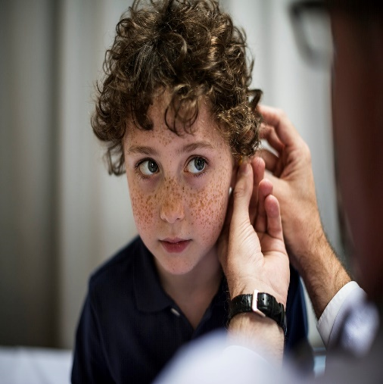
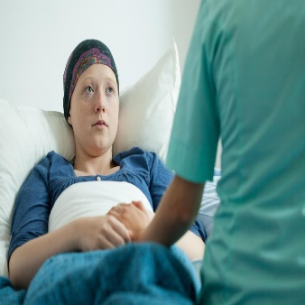
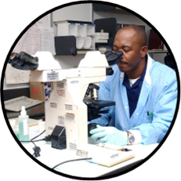

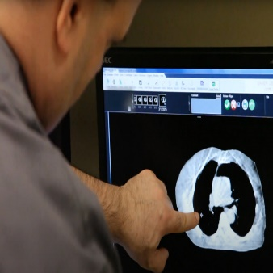
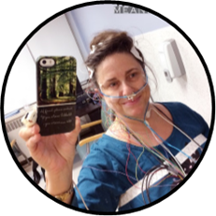
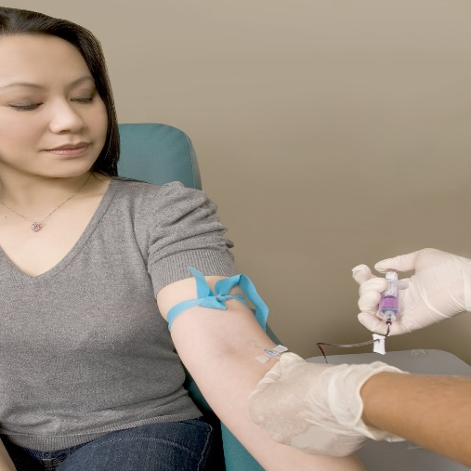
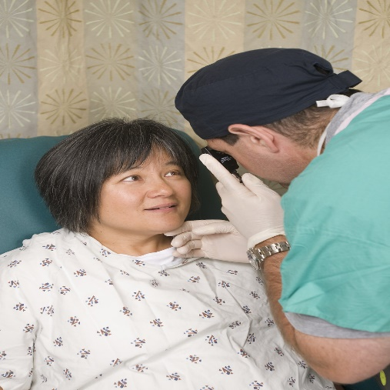
Diagnostics Programme
Acute and Specialist Trust Collaborative
Diagnostics Programme
Thank you for your ongoing support.
We are collectively delivering better care for all our population.

